Slide 1
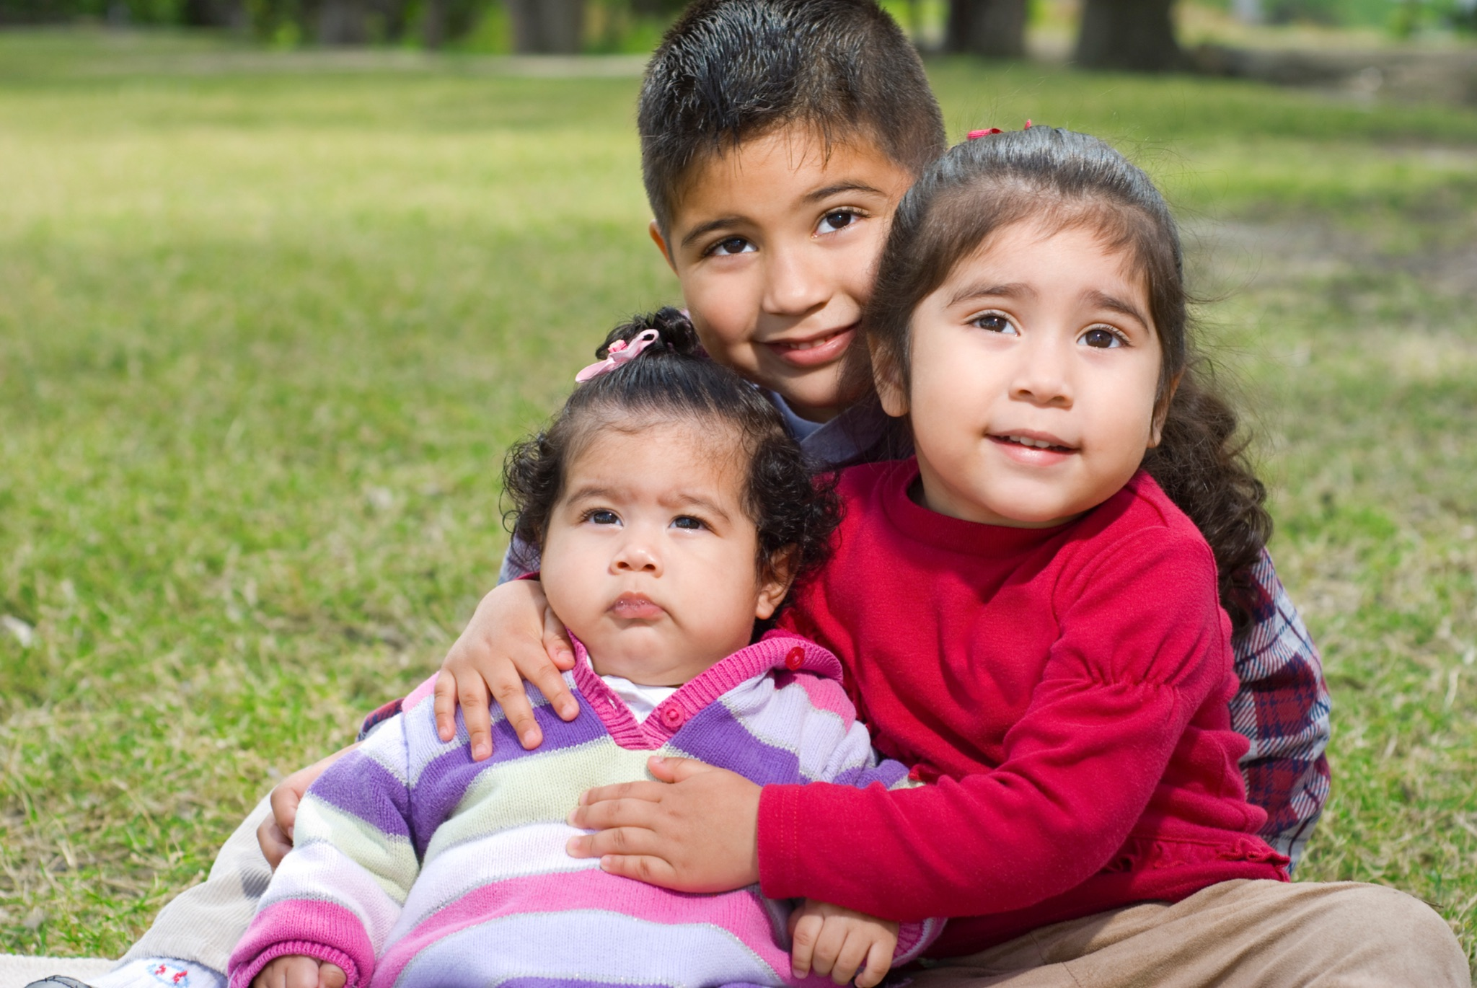
Flipchart for Community Health Workers:
The Importance of COVID Vaccines for Children 6 Months and Older.
HHS COVID Public Education Campaign
Content last reviewed:
May 5, 2023
A campaign to increase vaccine confidence while reinforcing basic prevention measures.
Notes:
Dear community health workers,
As part of the We Can Do This campaign, by the U.S. Department of Health and Human Services (HHS), we have prepared this flipchart on the importance of COVID vaccines for children ages 6 months and older.
We hope this will be a useful tool when reaching out to the Latino population, especially parents and guardians. Your role as trusted messengers and credible sources of information is critical to keeping our communities healthy. Children are our future, and vaccines are essential for their health and development.
This flipchart consists of 13 slides. It is designed so you can easily share this information. Each slide has a notes section at the bottom, which explains the slide content, provides recommended questions to ask the audience, and cites the sources of information. The entire presentation takes about 30-45 minutes.
At the end of the flipchart is an appendix with more information to help you in your work. It is not part of the flipchart to share with your community.
Thank you for your commitment and dedication to keeping our community healthy and protected.

Slide 2
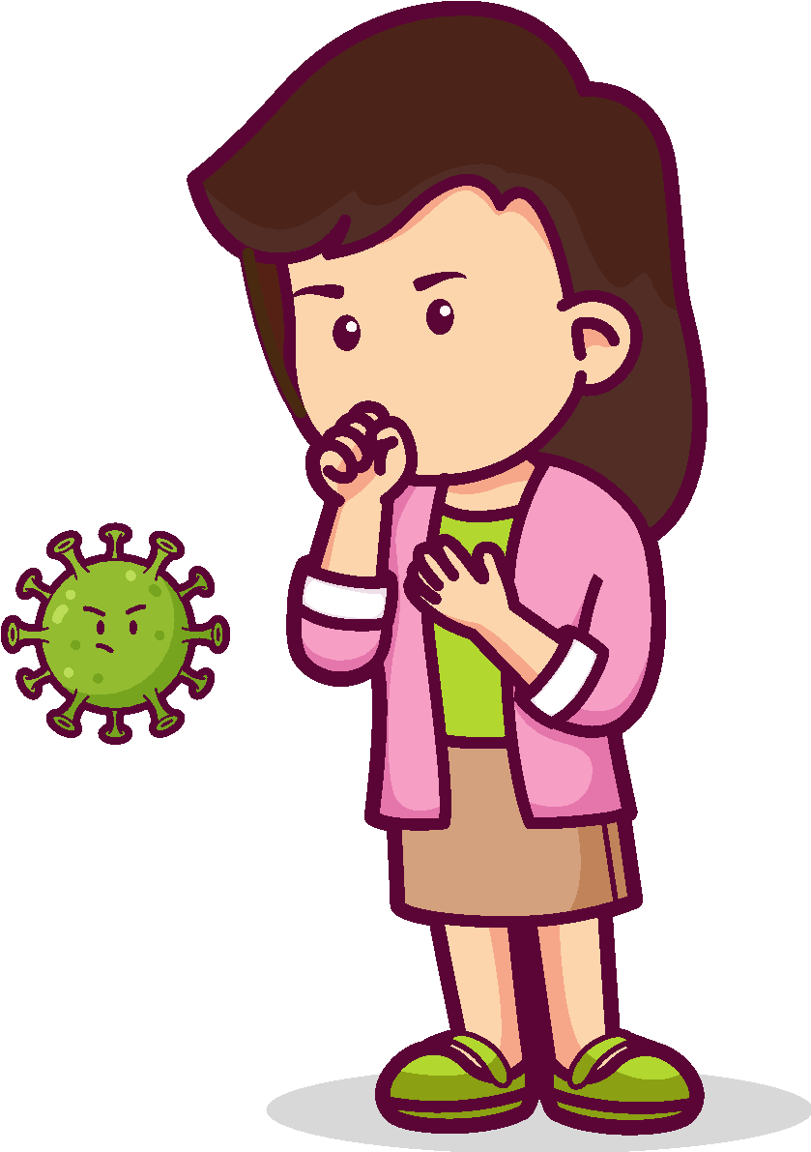
What is COVID and how does it spread?
It is a disease caused by the SARS-CoV-2 virus.
It is spread from an infected person to others by respiratory particles.
Inhaling through the nose or mouth.
Touching the eyes, nose or mouth with the hands.
Notes:
Ask the audience: Do you know what COVID is?
What is COVID and how does it spread?
COVID is an illness caused by the SARS-CoV-2 coronavirus.
Coronaviruses are a family of viruses that usually cause illness (from the common cold to more serious respiratory illnesses).
COVID is pandemic, meaning it has spread worldwide and affected millions of people.
COVID is highly contagious. When people infected with COVID exhale, they breathe out tiny droplets that contain the virus. You can get infected if:
You inhale these droplets with the virus inside them through your nose or mouth.
You touch your eyes, nose, or mouth with your hands that have the virus on them.
The closer you are to an infected person, the likelier you are to get infected if you don’t take precautions.
Older adults and people with underlying health conditions have an increased risk of serious illness.
Sources:
https://wecandothis.hhs.gov/resource/facts-about-covid-19-and-the-vaccines

Slide 3
COVID in children: The most important things you should know.
Notes:
Ask the audience: What should be considered when deciding if a child should be vaccinated against COVID?
COVID in children: The most important things you should know
Children are at risk of severe illness, hospitalization, and even death from COVID.
Children who get COVID can have short- and long-term complications, including inflammation in different parts of the body.
Children with COVID can infect others at home and at school.
Children who get sick may miss several days of school, which can affect their learning.
Sources:
https://www.cdc.gov/coronavirus/2019-ncov/vaccines/faq-children.html
https://wecandothis.hhs.gov/resource/resources-about-covid-19-vaccinations-for-children

Slide 4
These are the most common symptoms of COVID in children:
Fever or chills
Cough
Difficulty breathing
Fatigue
Body aches
Headache
Loss of smell or taste
Sore throat
Congestion or runny nose
Nausea or vomiting
Diarrhea
Notes:
Ask the audience: What have you heard about COVID symptoms for children? Does anyone who has had a child with COVID want to share what symptoms they had?
Most common symptoms of COVID in children:
The symptoms of COVID in children are similar to the symptoms in adults.
Most children with COVID-19 have mild symptoms or they may have no symptoms at all (“asymptomatic”).
Symptoms can appear 2–14 days after a child has been exposed to the virus.
These are the most common symptoms related to COVID in children, also commonly found in adults:
Fever or chills
Cough
Difficulty breathing (shortness of breath)
Fatigue
Muscle and body aches
Headache
Loss of smell or taste
Sore throat
Congestion or runny nose
Nausea or vomiting
Diarrhea
This list does not include all possible symptoms. Also, since many of these symptoms are common in other diseases, the only way to know if you have COVID is to get tested.
Call your child's medical provider for any symptoms that are severe or concerning to you.
A child can be infected with COVID and not have any symptoms.
Sources:
https://www.cdc.gov/coronavirus/2019-ncov/symptoms-testing/symptoms.html
hthttps://www.cdc.gov/coronavirus/2019-ncov/your-health/understanding-risk.html

Slide 5
The most important
actions to protect children:
Get vaccinated
Wear a mask when needed
Social distancing as needed
Wash your hands
Notes:
Ask the audience: How can we protect children against COVID?
The most important actions to protect children:
COVID Vaccines
They reduce your risk of severe illness, hospitalization, and death from COVID. Even with the variants, vaccines protect children from getting seriously ill if they get COVID.
Masks
Everyone ages 2 and older, regardless of vaccination status, should properly wear a well-fitting mask inside public places where CDC says the risk COVID poses to the community is high.
Wearing a well-fitting mask over your nose and mouth can reduce the spread of COVID, especially in public places and in enclosed spaces where there is close proximity to other people.
It’s especially important for children who are unvaccinated to wear a mask, or if they have a chronic disease (such as diabetes), a weakened immune system, or a serious medical condition.
Wearing a mask protects the children wearing it and those around them.
Social Distancing
Inside the home: children should avoid close contact with people who are sick. The sick person should isolate themselves from others in the home.
Indoors in public: If you are not up to date on COVID vaccines, stay at least 6 feet away from other people, especially if you are at higher risk of getting very sick with COVID.
Avoid crowds and poorly ventilated spaces.
Washing Hands Often With Soap and Water
Children should wash their hands for at least 20 seconds, especially after they have been in a public place or after blowing their nose, coughing, or sneezing.
If soap and water are not available, they should use a hand sanitizer that contains at least 60% alcohol.
Sources:
https://wecandothis.hhs.gov/resource/lets-work-together-to-stop-the-spread-of-covid-19
https://www.cdc.gov/coronavirus/2019-ncov/vaccines/index.html
https://www.cdc.gov/coronavirus/2019-ncov/if-you-are-sick/steps-when-sick.html
https://www.cdc.gov/coronavirus/2019-ncov/if-you-are-sick/index.html
https://www.cdc.gov/coronavirus/2019-ncov/vaccines/stay-up-to-date.html
https://www.cdc.gov/coronavirus/2019-ncov/prevent-getting-sick/prevention.html

Slide 6
The importance of vaccines for children against a virus that is constantly changing.
Notes:
Ask the audience: Why do you think COVID vaccines for children are so important?
Importance of the vaccines:
COVID vaccines help protect children against severe illness, hospitalization, and death, including from highly contagious variants. But children who are vaccinated can still get infected and infect others.
The COVID virus is constantly mutating, creating variants. Some variants have disappeared, while others continue to infect people, including children, and more variants are expected to appear.
No child should go to the hospital for a disease that is preventable. We have the vaccines; let's use them.
Some side effects may occur after getting the COVID vaccine, such as: pain, redness, and swelling in the arm at the injection site; tiredness; headache; muscle pain; chills; fever; and nausea.
Don’t give your child over-the-counter medicine (such as ibuprofen, aspirin, or acetaminophen) before vaccination to prevent side effects. But they can take them afterward to help alleviate side effects.
It is important to keep the vaccination card safe and take a photo of it as a precaution. Take the card with you each time you go to get a shot.
Sources:
https://wecandothis.hhs.gov/resource/what-know-about-coronavirus-variants
https://www.cdc.gov/coronavirus/2019-ncov/vaccines/booster-shot.html
https://wecandothis.hhs.gov/resource/vaccine-confidence-presentation-for-latino-audiences
https://wecandothis.hhs.gov/resource/get-covid-19-vaccine-info-whatsapp
https://www.cdc.gov/coronavirus/2019-ncov/variants/understanding-variants.html
https://www.cdc.gov/coronavirus/2019-ncov/need-extra-precautions/index.html
https://www.cdc.gov/coronavirus/2019-ncov/vaccines/vaccination-card.html

Slide 7
COVID Vaccine Dose Recommendations for Unvaccinated Individuals as of April 2023
Notes:
Ask the audience: Which COVID vaccine can I get to my child?
Everyone 6 months and older can get either the Pfizer-BioNTech or Moderna vaccine.
People 12 and older can also choose the Novavax vaccine.
How many vaccine doses do I need for the best protection?
The number of doses you need to stay up to date with your vaccines depends on your age and which vaccine you get.
People with compromised immune systems are less able to fight infections and may need more than these recommended doses.
Updated vaccines are available for people 6 months and older to help protect against Omicron.
Sources:
https://www.cdc.gov/coronavirus/2019-ncov/vaccines/stay-up-to-date.html
https://www.cdc.gov/coronavirus/2019-ncov/vaccines/recommendations/immuno.html

Slide 8
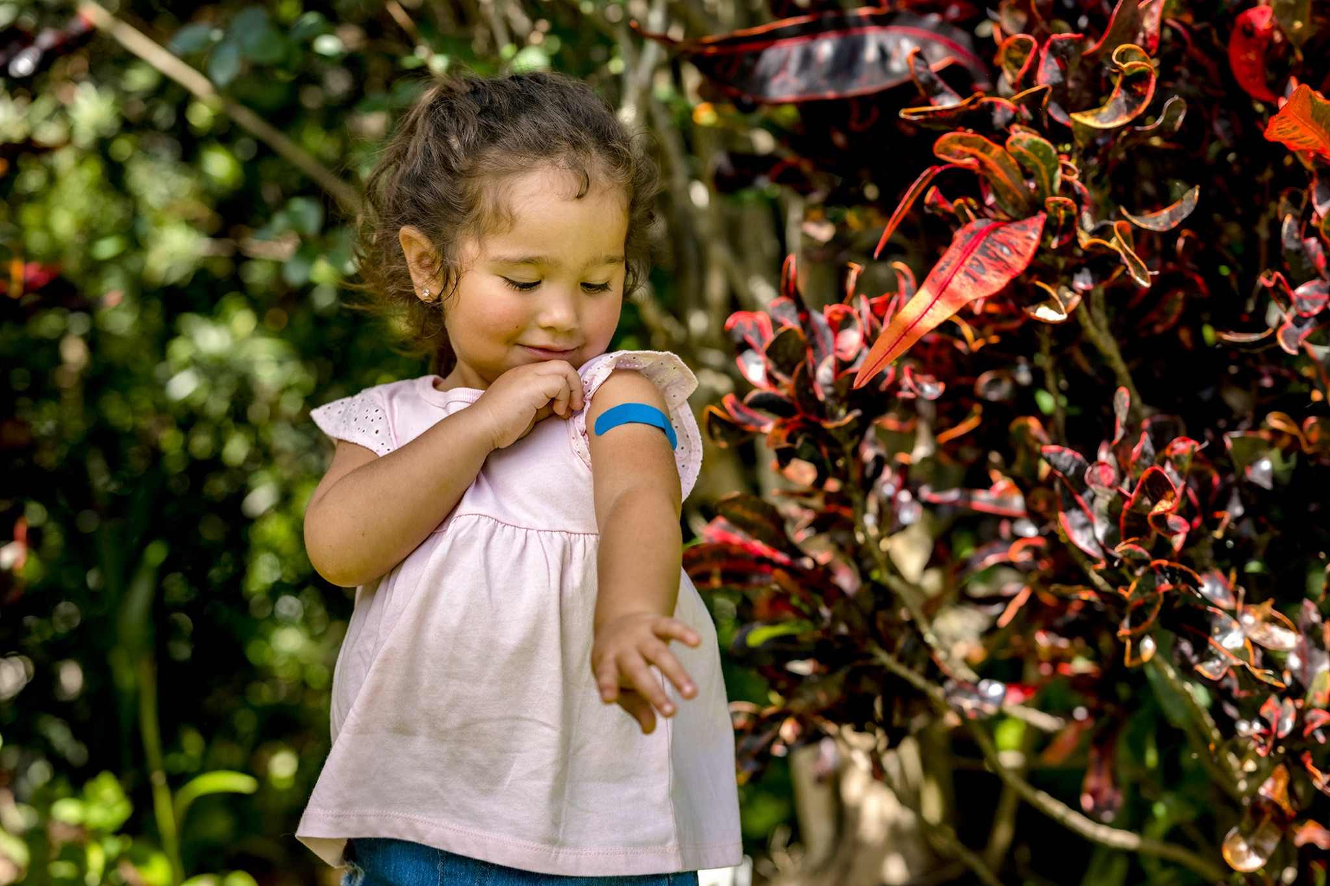
Are COVID vaccines safe?
Yes! Vaccines are the best way to protect children.
Notes:
Ask the audience: Why do some parents have doubts about vaccinating their children against COVID?
Are COVID vaccines safe?
Vaccinating children ages 6 months and older against COVID is the best way to protect them from getting seriously ill, being hospitalized, or dying from COVID.
COVID vaccines are safe for children and adolescents.
Millions of children have gotten COVID vaccines under the most rigorous safety monitoring in the history of the United States.
A child can receive the COVID vaccine and other vaccines, such as the flu vaccine, at the same time.
There is no evidence that COVID vaccines cause fertility problems or other long-term health problems.
Sources:
https://www.cdc.gov/coronavirus/2019-ncov/vaccines/recommendations/children-teens.html
https://www.cdc.gov/coronavirus/2019-ncov/groups/families-covid-19.html
https://www.cdc.gov/coronavirus/2019-ncov/vaccines/vaccine-benefits.html
https://www.cdc.gov/coronavirus/2019-ncov/vaccines/distributing/steps-ensure-safety.html
https://wecandothis.hhs.gov/resource/resources-about-covid-19-vaccinations-for-children

Slide 9
Why is it important for children 6 months and older to get an updated vaccine?
Updated vaccines keep them protected against COVID, including variants.
Notes:
Ask the audience: Why are updated vaccines needed?
Why is it important for children 6 months and older to get an updated vaccine?
Updated vaccines help protect against Omicron, which is the variant causing all new COVID infections.
When should children 6 months and older get an updated vaccine?
Children should get an updated COVID vaccine now if they’re:
12–17 years, got a Pfizer-BioNTech or Novavax vaccine, and their last dose was before September 2022.
6–17 years, got a Moderna vaccine, and their last dose was before October 2022.
5–11 years, got a Pfizer-BioNTech vaccine, and their last dose was before October 2022.
6 months – 5 years, got a Moderna vaccine, and their last dose was before December 2022.
6 months – 4 years, got a Pfizer-BioNTech vaccine, and their last dose was before December 2022.
If your child is due for an updated COVID vaccine but recently had COVID, they can wait 3 months from when they got sick to get their updated COVID vaccine.
Sources:
https://wecandothis.hhs.gov/resource/updated-covid-vaccines-toolkit
https://www.cdc.gov/coronavirus/2019-ncov/vaccines/stay-up-to-date.html

Slide 10
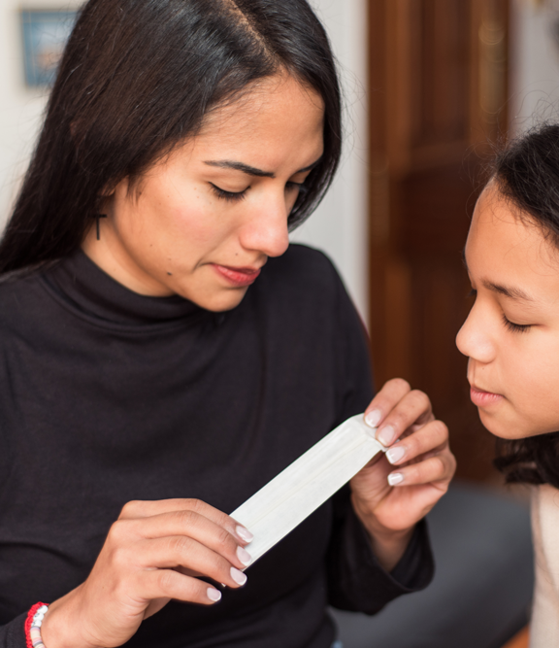
COVID testing:
Rapid (antigen) tests
Laboratory tests
Notes:
Ask the audience: Is it possible to test a child for COVID at home? Where can a child be tested?
COVID Tests
They are essential to help reduce the spread of COVID.
A viral test tells you if you are infected with the virus. Viral tests use samples from your nose or mouth.
You can go to several places to get tested, or you can test a child at home.
What is the difference?
There are two types of viral tests: rapid (antigen) tests and laboratory tests (including RT-PCR tests).
Rapid tests can be done at home, and you get the results within minutes. But these tests may not be as reliable. A follow-up test may be needed.
Laboratory tests may take a few days but offer more accurate results.
The PCR tests work whether you have COVID symptoms or not, or whether you are up to date with your COVID vaccinations.
Find out where to get tests at covid.gov/tests
Sources:
https://www.cdc.gov/coronavirus/2019-ncov/testing/self-testing.html
https://www.cdc.gov/coronavirus/2019-ncov/symptoms-testing/testing.html

Slide 11
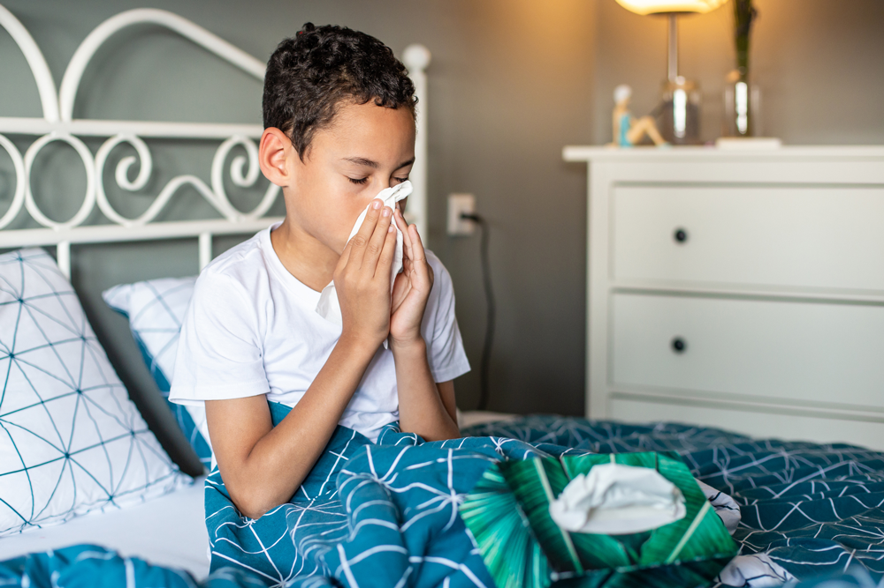
What can children exposed to COVID do to reduce their chances of spreading the virus to others?
Notes:
Ask the audience: Do you know a child who has been exposed to COVID?
After Being Exposed to COVID, Regardless of Vaccination Status
Begin wearing a mask around others as soon as you find out you were exposed.
It can take up to 10 days after being exposed to COVID to come down with COVID yourself. Continue wearing a mask around others for 10 days and watch for symptoms.
Get tested at least 5 full days after being exposed, even if you don’t have any symptoms.
If you develop symptoms or test positive, isolate immediately for at least 5 days.
When can children who got COVID return to school or their activities?
End isolation based on how serious your COVID symptoms were.
You may end isolation 5 days after testing positive if you had no symptoms.
Continue to isolate until your symptoms improve and you are fever-free for 24 hours (without the use of fever-reducing medication).
Wear a mask around others for at least 10 days after testing positive or developing symptoms. You may stop wearing a mask around others sooner if you test negative for COVID once and then test negative again 48 hours later.
Sources:
https://www.cdc.gov/coronavirus/2019-ncov/community/schools-childcare/k-12-guidance.html
https://www.cdc.gov/coronavirus/2019-ncov/testing/self-testing.html
https://www.cdc.gov/coronavirus/2019-ncov/your-health/isolation.html
https://www.cdc.gov/coronavirus/2019-ncov/if-you-are-sick/steps-when-sick.html
https://www.cdc.gov/coronavirus/2019-ncov/symptoms-testing/testing.html

Slide 12
Myths and misinformation
False?
True?
Notes:
Group exercise:
Do you know what a myth is? Do you know how to distinguish false information from factual information?
A myth is a traditional story based on beliefs of different communities, which presents explanations of facts or phenomena not necessarily based on reality.
Example of a current myth:
Myth: With good nutrition, hygiene, and exercise, it is not necessary to get vaccinated.
Reality: Although good nutrition, hygiene, and exercise are important, there are diseases that only vaccines can protect you from.
Can anyone share a myth they heard as a child?
Thank you for sharing.
Once the myth has spread, many people begin to think that it’s real.
The same thing happens with misinformation about COVID vaccines.
There have been many myths about COVID vaccination, such as those that say the vaccine will affect your fertility, that it modifies your DNA, that it can magnetize, or that it contains microchips, among many others. But we can learn to distinguish a myth or misinformation from facts.
It is important that we ask ourselves the following about the information we receive and share:
Who sent the information? What is the message about? Is the image real? Does it come from a reliable source? Where did they get the information? What is the purpose? What is the author's expertise? Among others. DO NOT SHARE INFORMATION THAT IS NOT TRUE.
Sources:
https://wecandothis.hhs.gov/outreach-tools/addressing-covid-19-vaccine-misconceptions

Slide 13
What did we learn?
Notes:
Dynamics with the public:
I am going to read you a sentence, and you tell me if it is true or false.
It is too late to get the first COVID vaccine shot. True or false?
-False. Currently, all vaccine doses are available to everyone who is eligible, and we are going to go over where you can find vaccines.
COVID vaccines for children are not safe. True or false?
-False. COVID vaccines for children 6 months and older have undergone extensive evaluation by CDC and the U.S. Food and Drug Administration. COVID vaccines have undergone and will continue to undergo the most rigorous safety monitoring in U.S. history.
It is safer for my child to get immunity by getting COVID than through vaccination. True or false?
-False. Vaccinating children 6 months and older against COVID is the best way to protect them from becoming infected with COVID. No one should try to expose themselves to COVID or expose another person on purpose because they risk getting seriously ill.
Sources:
https://www.cdc.gov/coronavirus/2019-ncov/vaccines/facts.html
https://www.cdc.gov/vaccines/vac-gen/evalwebs.htm

Slide 14
For more information about the COVID-19 vaccines, scan this QR code.
Find COVID vaccines near you:
Ask a doctor
Visit the website vaccines.gov
Call 1-800-232-0233
Text your ZIP code to 438829
Stay informed of community events hosted by schools, clinics, churches, and other community organizations
Notes:
Find COVID vaccines and boosters near you
Ask a doctor
Visit the website vaccines.gov
Call 1-800-232-0233
Text your ZIP code to 438829
Stay informed of community events hosted by schools, clinics, churches, and other community organizations
In addition to the QR code, you can share these information sources with parents:
https://wecandothis.hhs.gov/resource/resources-about-covid-19-vaccinations-for-children
https://www.cdc.gov/coronavirus/2019-ncov/vaccines/faq-children.html
https://www.cdc.gov/coronavirus/2019-ncov/community/schools-childcare/child-care-guidance.html

Slide 15
vaccines.gov| vacunas.gov
Notes:
APPENDIX (INTERNAL USE)
INTERNAL GUIDE FOR COMMUNITY HEALTH WORKERS:
Our role as community health workers is critical: It is our duty to help our community!
What can we do to help our communities?
Be the example: Get vaccinated, wear a well-fitting mask, and keep a safe distance from others.
Do not circulate false information or information that is not supported by official sources. Only share information from legitimate sources.
Suggested Activities
Distribute educational materials about the symptoms of COVID and how it spreads.
Answer questions from community members about COVID and debunk myths, rumors, and misinformation circulating in the community.
Educate to reduce stigma against community members who have been diagnosed with COVID.
Organize support networks to help community members with COVID who are in isolation or quarantine.
Promote COVID prevention measures, including frequent handwashing, wearing masks correctly, and getting vaccinated, including the booster.
Encourage community members to get tested for COVID if they have symptoms or have been in close contact with infected people.
Help eliminate the fear of getting vaccinated or requesting a COVID test.
Use social networks to promote information based on scientific evidence.
What you should NOT do
Gather groups of many people.
Go to homes, unless necessary to provide assistance. In the rare situation that you have to go to a home, you should wear the proper personal protective equipment (PPE).
Touch someone who is sick without proper PPE.
Learn more about how to find reliable vaccine information and share it with your community
Learn what a website domain means:
*.edu When a website ends in “.edu” the information comes from an organization associated with a university or educational institution.
*.gov/.gob When a website ends in “.gov/gob” the information comes from a government organization.
*.org When a website ends with “.org” the information comes from a nonprofit organization.
*.com When a website ends with “.com” the information comes from a private organization.
Be careful if:
The information is from an anonymous source.
There is a conflict of interest (the authors/organization get paid to promote certain information).
Only one perspective is presented.
Information is old/outdated.
A miracle or secret cure is claimed.
Claims are not supported by strong evidence.
If you have questions about the information you received or want to share, ask a doctor, your local clinic, or verify the information with reliable sources.
Sources:
https://www.cdc.gov/coronavirus/2019-ncov/global-covid-19/home-based-care.html#anchor_1628538263343
https://wecandothis.hhs.gov/resource/community-health-workers-toolkit
https://www.ucsfhealth.org/education/evaluating-health-information
https://www.cdc.gov/vaccines/vac-gen/evalwebs.htm
https://wecandothis.hhs.gov/

