Slide 1
Parent Leader Meeting in a Box
Resources for parent leaders to have conversations about
school COVID-19 and vaccine guidelines.

Slide 2
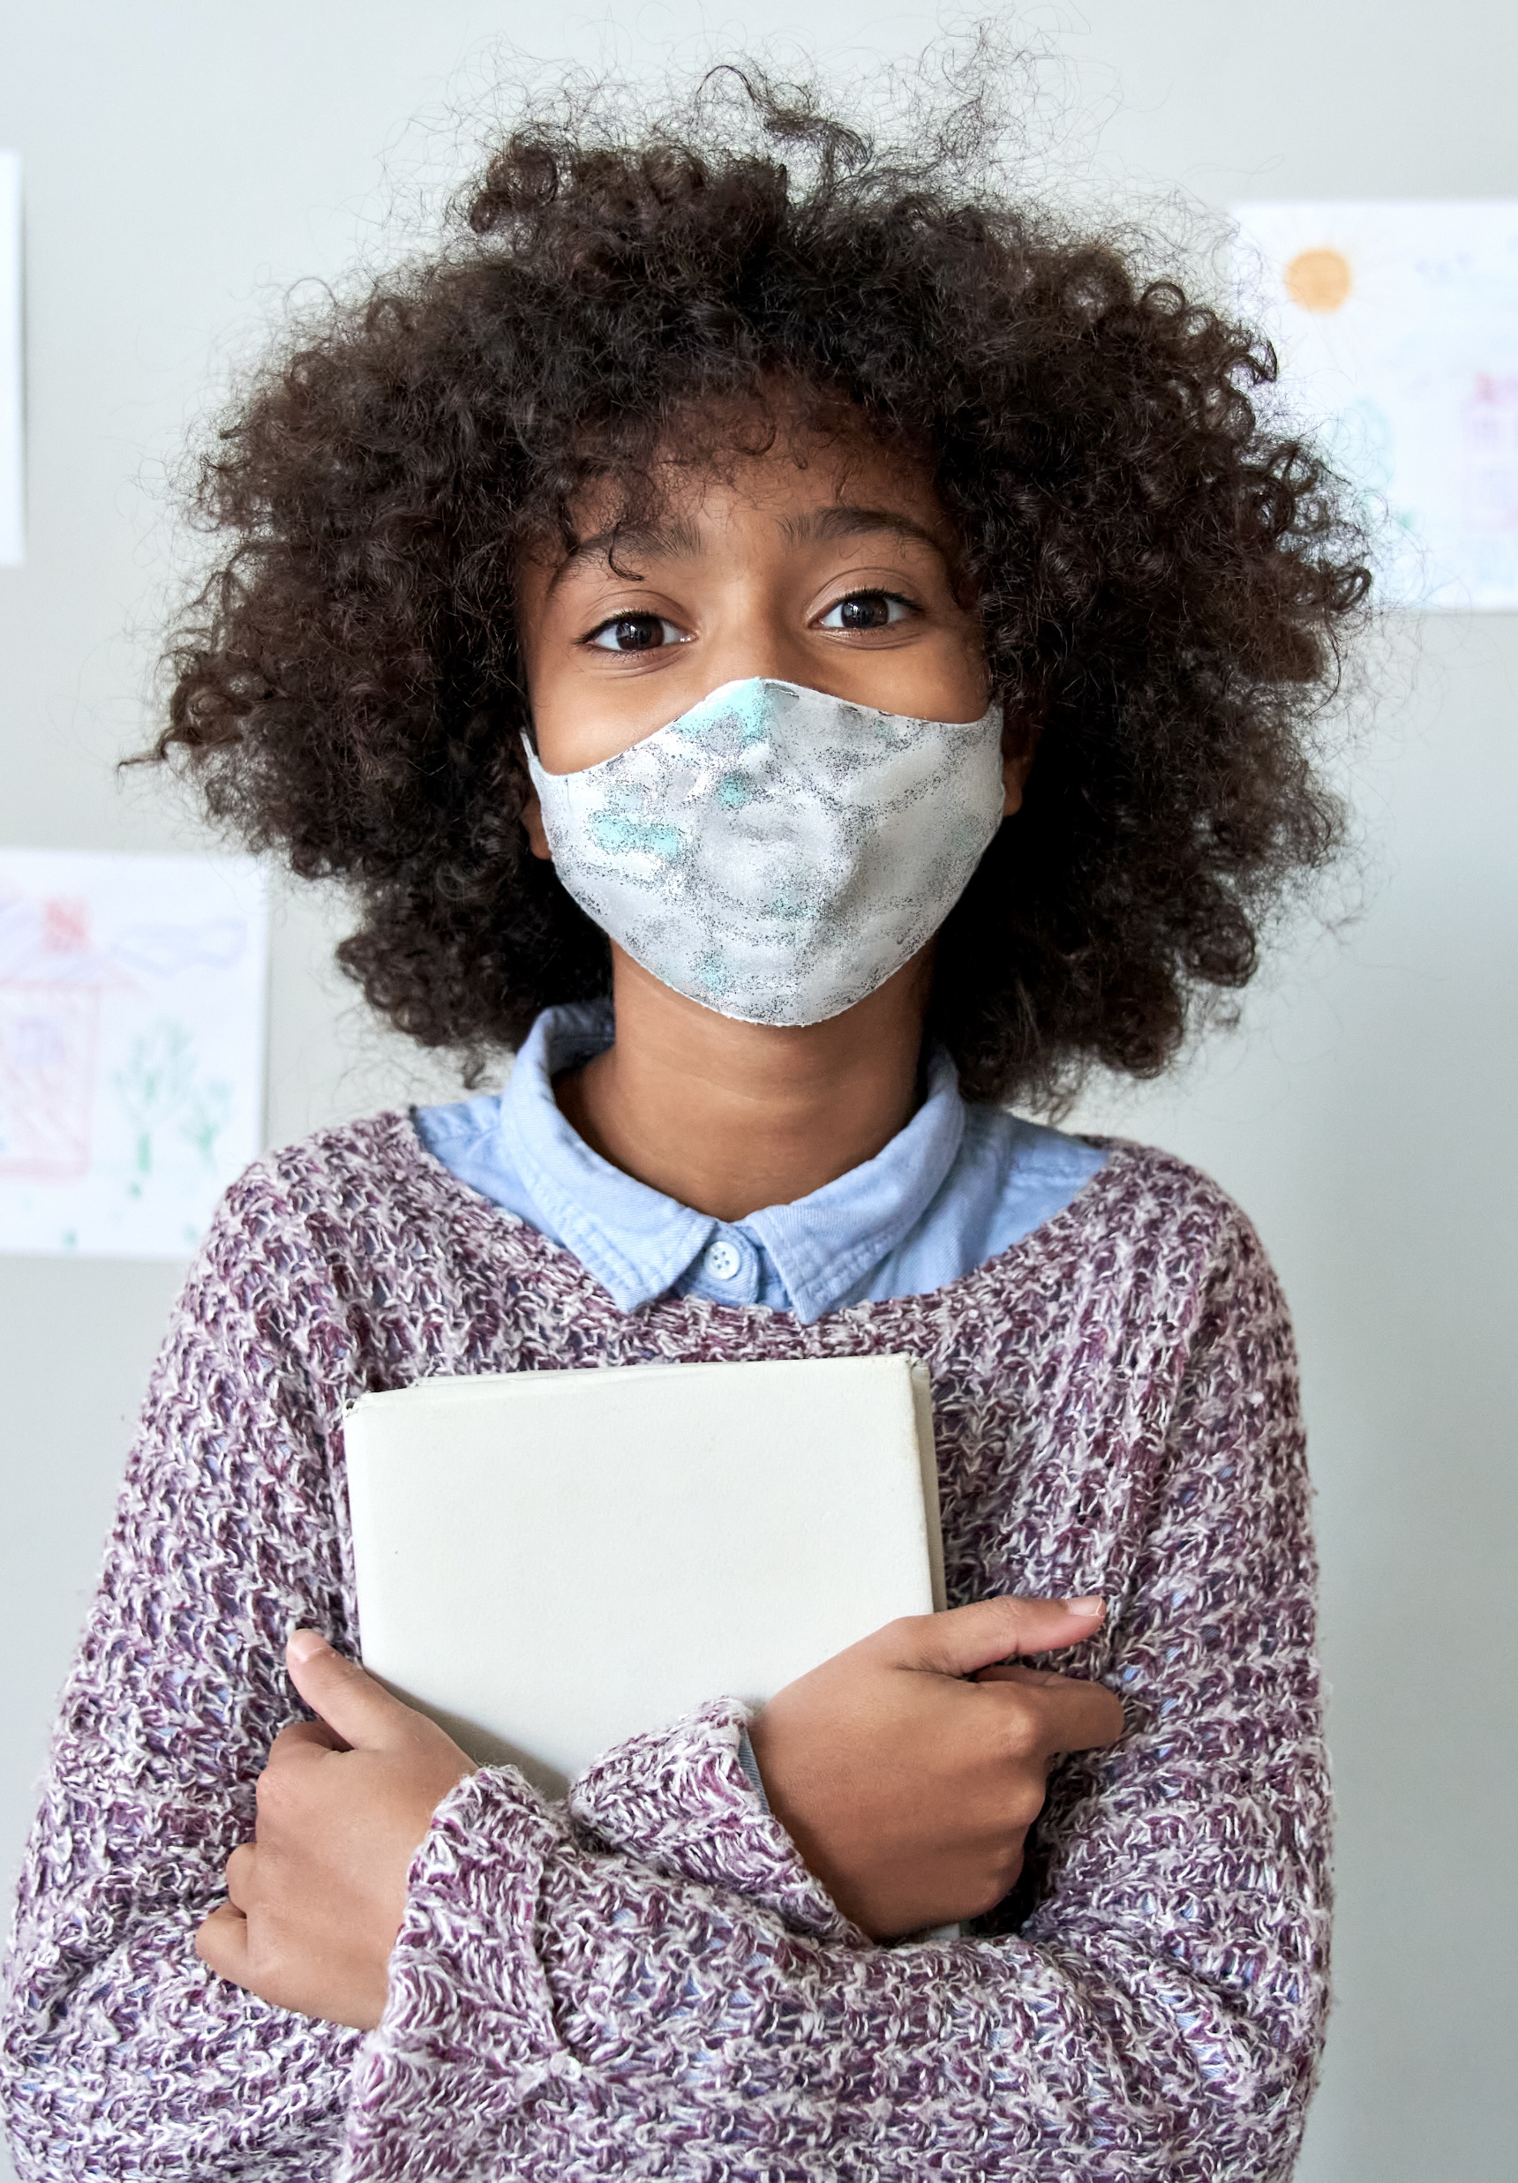
Meeting in a Box Contents
About the We Can Do This Campaign
Tips for Conducting Safe Meetings
Talking Points
Links to Helpful Resources
Meeting Presentation Template

Slide 3
About the We Can Do This Campaign

Slide 4
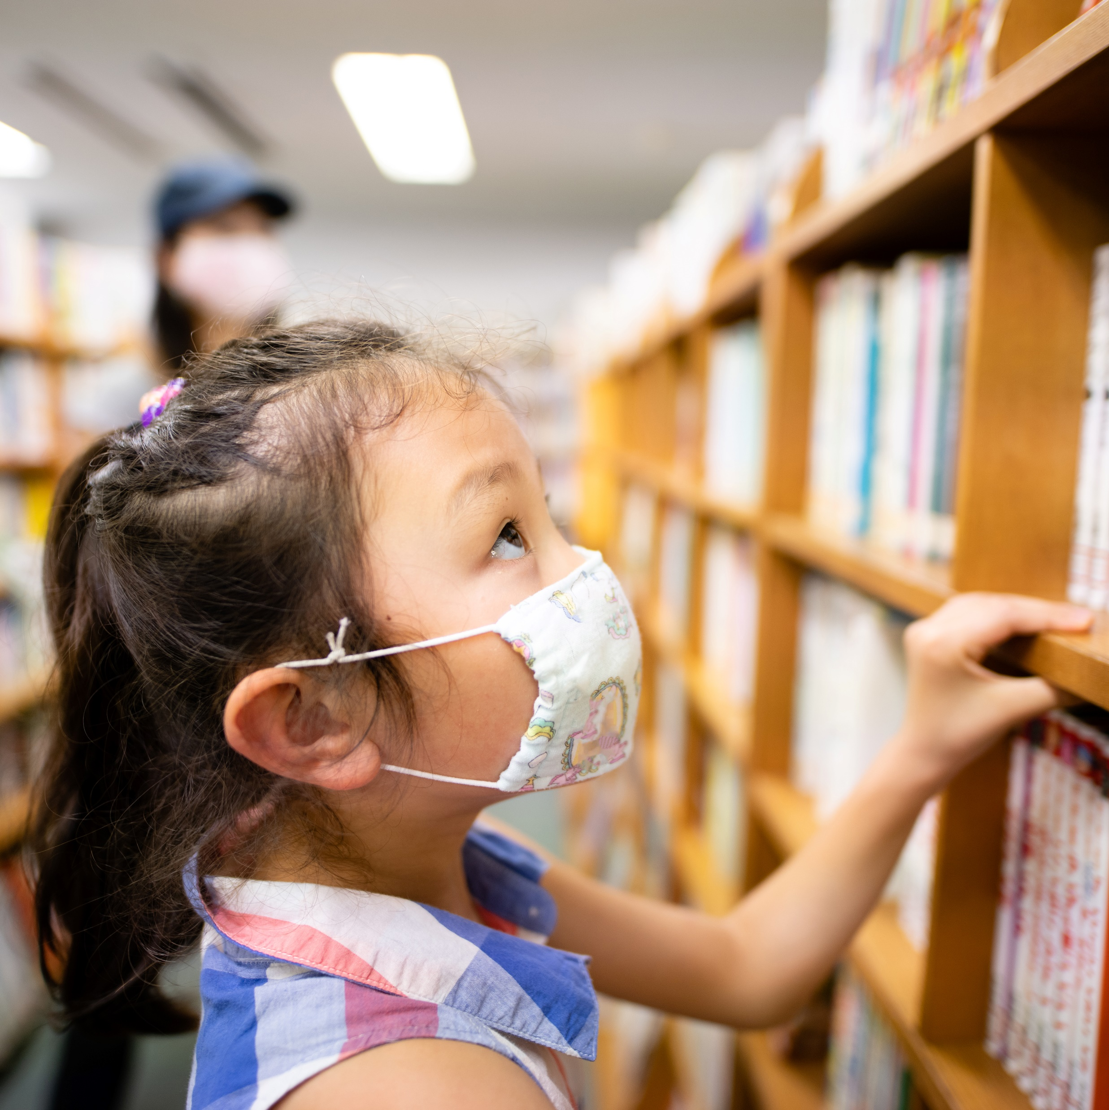
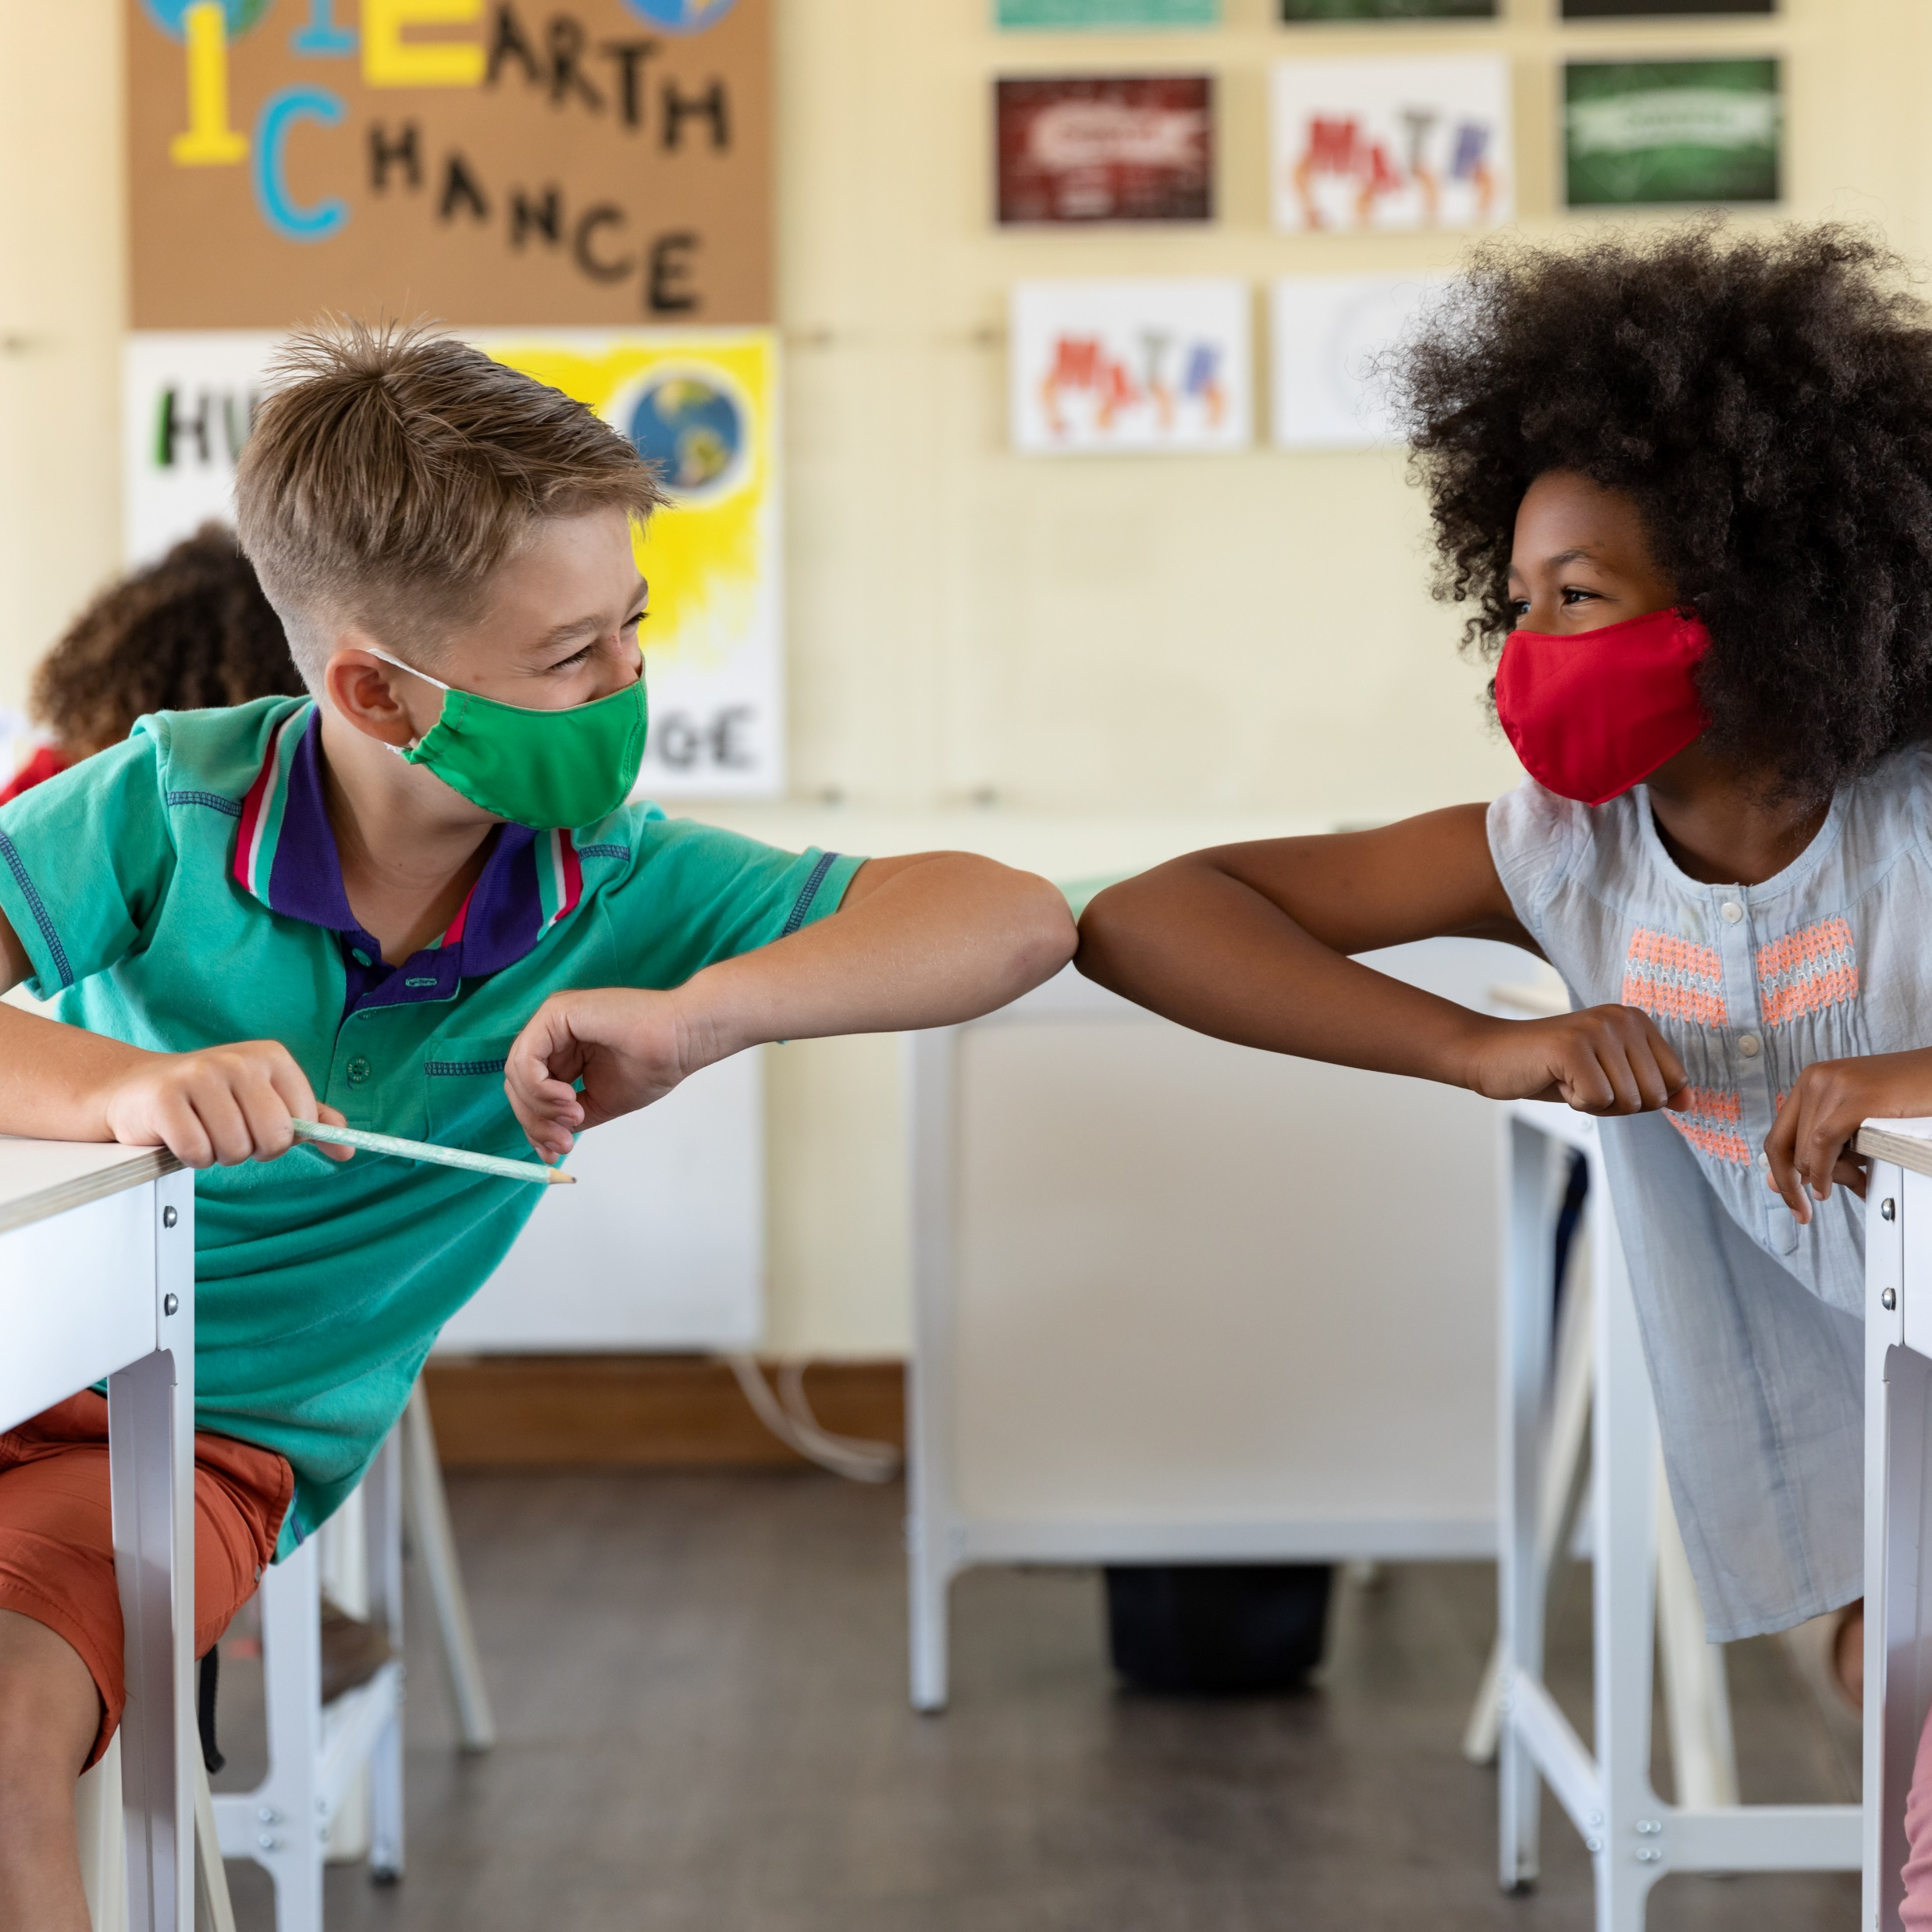
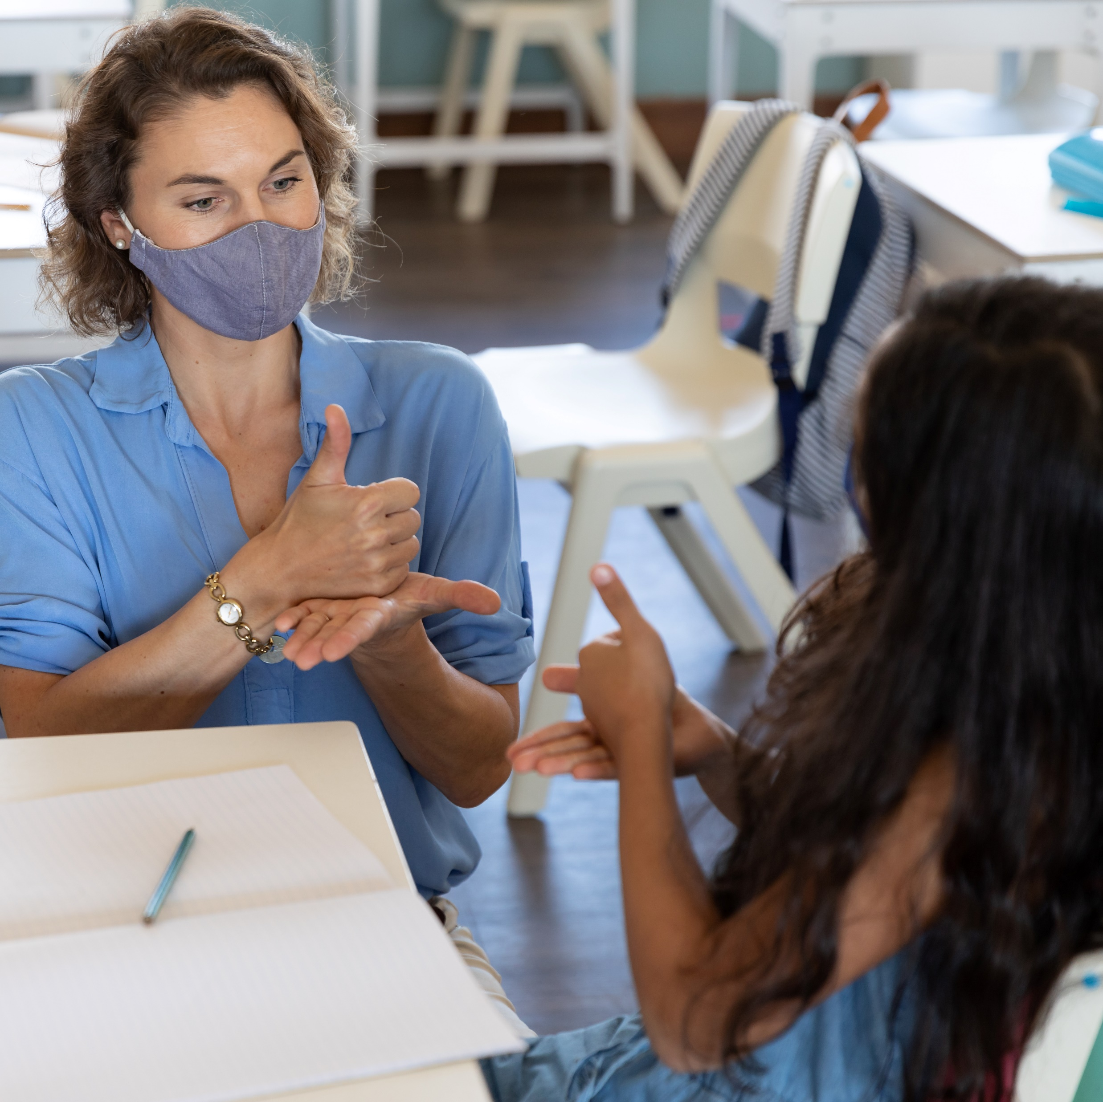
We Can Do This Campaign
The U.S. Department of Health and Human Services (HHS) COVID-19 Public Education Campaign is a national initiative to increase public confidence in and uptake of COVID-19 vaccines while reinforcing basic prevention measures such as mask wearing and social distancing.
Through a nationwide network of trusted messengers like you and consistent, fact-based public health messaging, the Campaign helps people make informed decisions about their health and COVID-19, including steps to protect themselves and their communities.

Slide 5
Tips for Conducting Safe Meetings

Slide 6
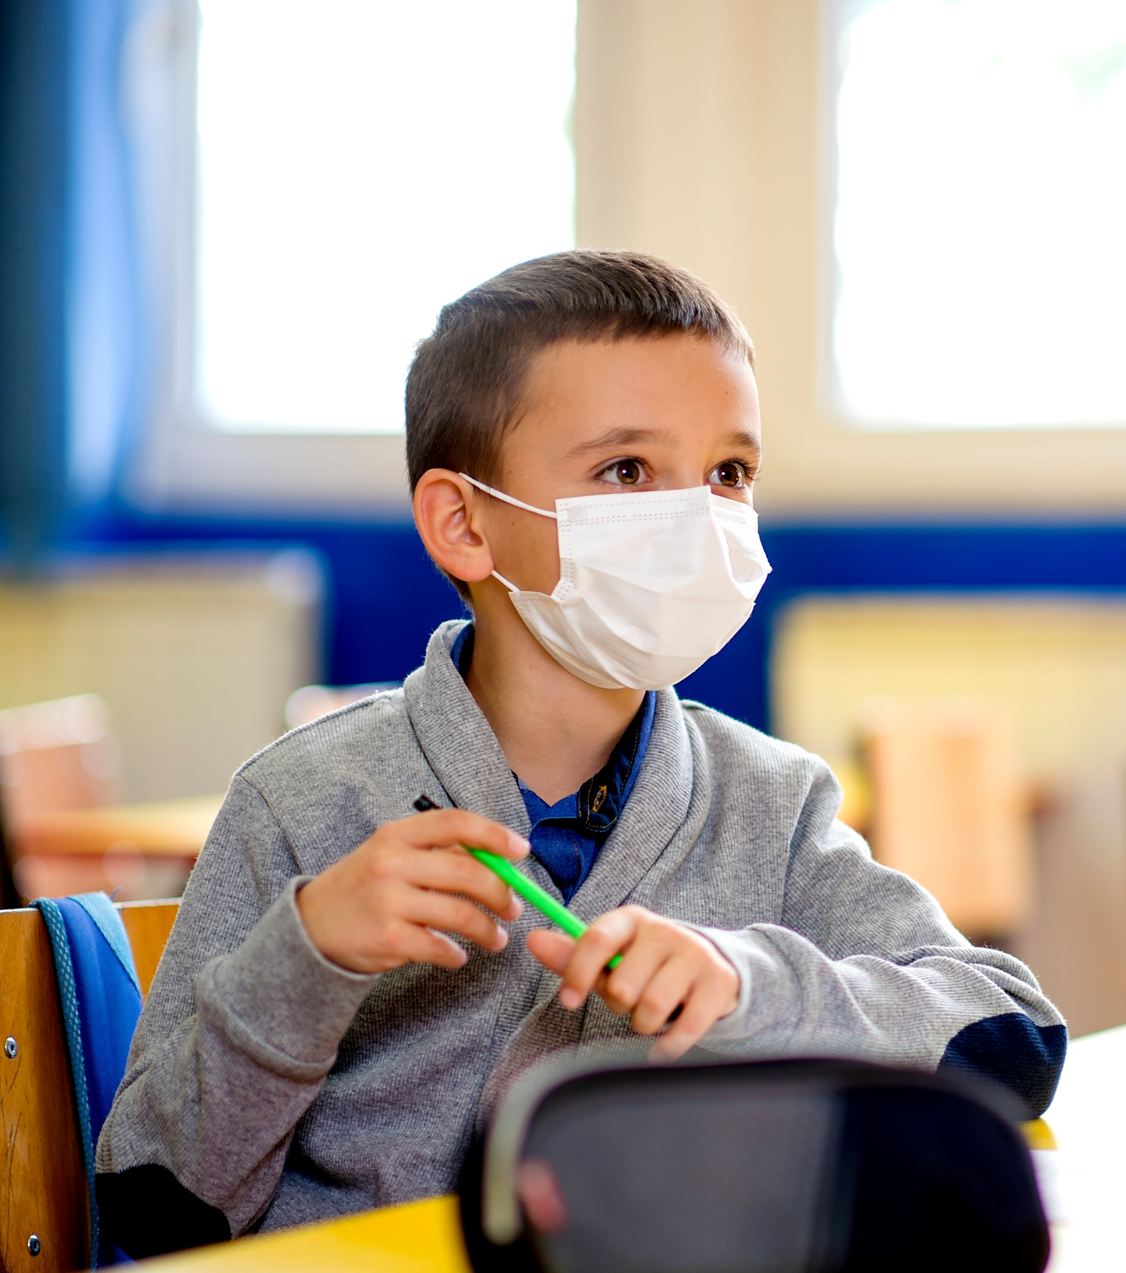
Tips for Conducting Safe Meetings
Virtual meetings are safest. But you can have “safer” in-person meetings if you follow recommended precautions.
Ensure there is enough space for physical distancing.
Require everyone in attendance to wear well-fitting masks that completely cover their nose and mouth when the COVID risk to your community is high.
Offer hand sanitizer with at least 60% alcohol.
Hold meetings in well-ventilated rooms. Consider holding your meeting outdoors if possible.
Encourage anyone with COVID-19 symptoms to stay home.
Clean meeting spaces before and after the event.
Check out the CDC website for more guidance on organizing meetings.

Slide 7
Talking Points

Slide 8
Talking Points
Use these fact-based talking points in your messaging with fellow educators and parents.
Question | Talking Points
Are COVID-19 vaccines safe for kids? | The COVID-19 vaccine was rigorously tested in thousands of children before authorization by the FDA. The vaccine was shown to be safe and effective during the clinical trials. Children had the same kinds of temporary side effects from vaccines as adults. Side effects during the clinical trials were usually mild and went away on their own in a few days. COVID-19 vaccines are being used under the most intensive safety monitoring in U.S. history.
Do kids really need a vaccine if they’re young and healthy? | Children can still get sick and get long-term complications from the virus. They can also spread it to others.
Will getting a COVID vaccine change my DNA? | COVID-19 vaccines do not change or interact with your DNA in any way. The genetic material in the vaccines never enters the nucleus of the cell where DNA is kept.
Will getting a COVID vaccine give me COVID? | None of the vaccines contain the live virus that causes COVID-19, so they cannot make you sick with COVID-19.
If I’ve already had COVID-19, do I need a vaccine? | Evidence shows that being vaccinated after having COVID-19 strengthens immunity to give you better protection.
Do COVID-19 vaccines affect fertility? | Currently, no evidence indicates that any vaccines, including COVID-19 vaccines, cause fertility problems in women or men.
Do COVID-19 vaccines cause long-term health effects? | Serious side effects that would cause a long-term health problem are extremely rare following COVID-19 vaccination. The risk of a serious illness from COVID-19 itself is much higher.

Slide 9
Talking Points (Continued)
Question | Talking Points
Will I or my child get myocarditis or pericarditis from receiving the Pfizer-BioNTech vaccine? | Reports of myocarditis or pericarditis (heart inflammation) following vaccination are extremely rare, given the hundreds of millions of vaccine doses that have been given. Most patients who received care responded well to treatment and rest and quickly felt better. It’s important to note that COVID-19 can also cause this kind of heart inflammation.
Can I get the COVID-19 vaccine while I’m on my period (or when my child is on their period)? | According to CDC and the American College of Obstetricians and Gynecologists, there’s no reason to put off getting vaccinated if someone is on their period. CDC and the FDA closely monitor safety data and have not seen any patterns of concern.
Do parents need to give consent before a vaccine is given to an eligible minor? | The federal government does not have specific requirements for medical consent for vaccination. States/jurisdictions have medical consent laws that address the circumstances under which a medical provider must seek consent prior to a medical procedure and the processes for obtaining that consent. These laws vary across jurisdictions. Providers may also be subject to policy requirements for consent within their own organizations.
Do the vaccines protect against the Omicron variant? | Current vaccines are expected to protect against severe illness, hospitalizations, and deaths due to infection with the Omicron variant.

Slide 10
Links to Helpful Resources

Slide 11
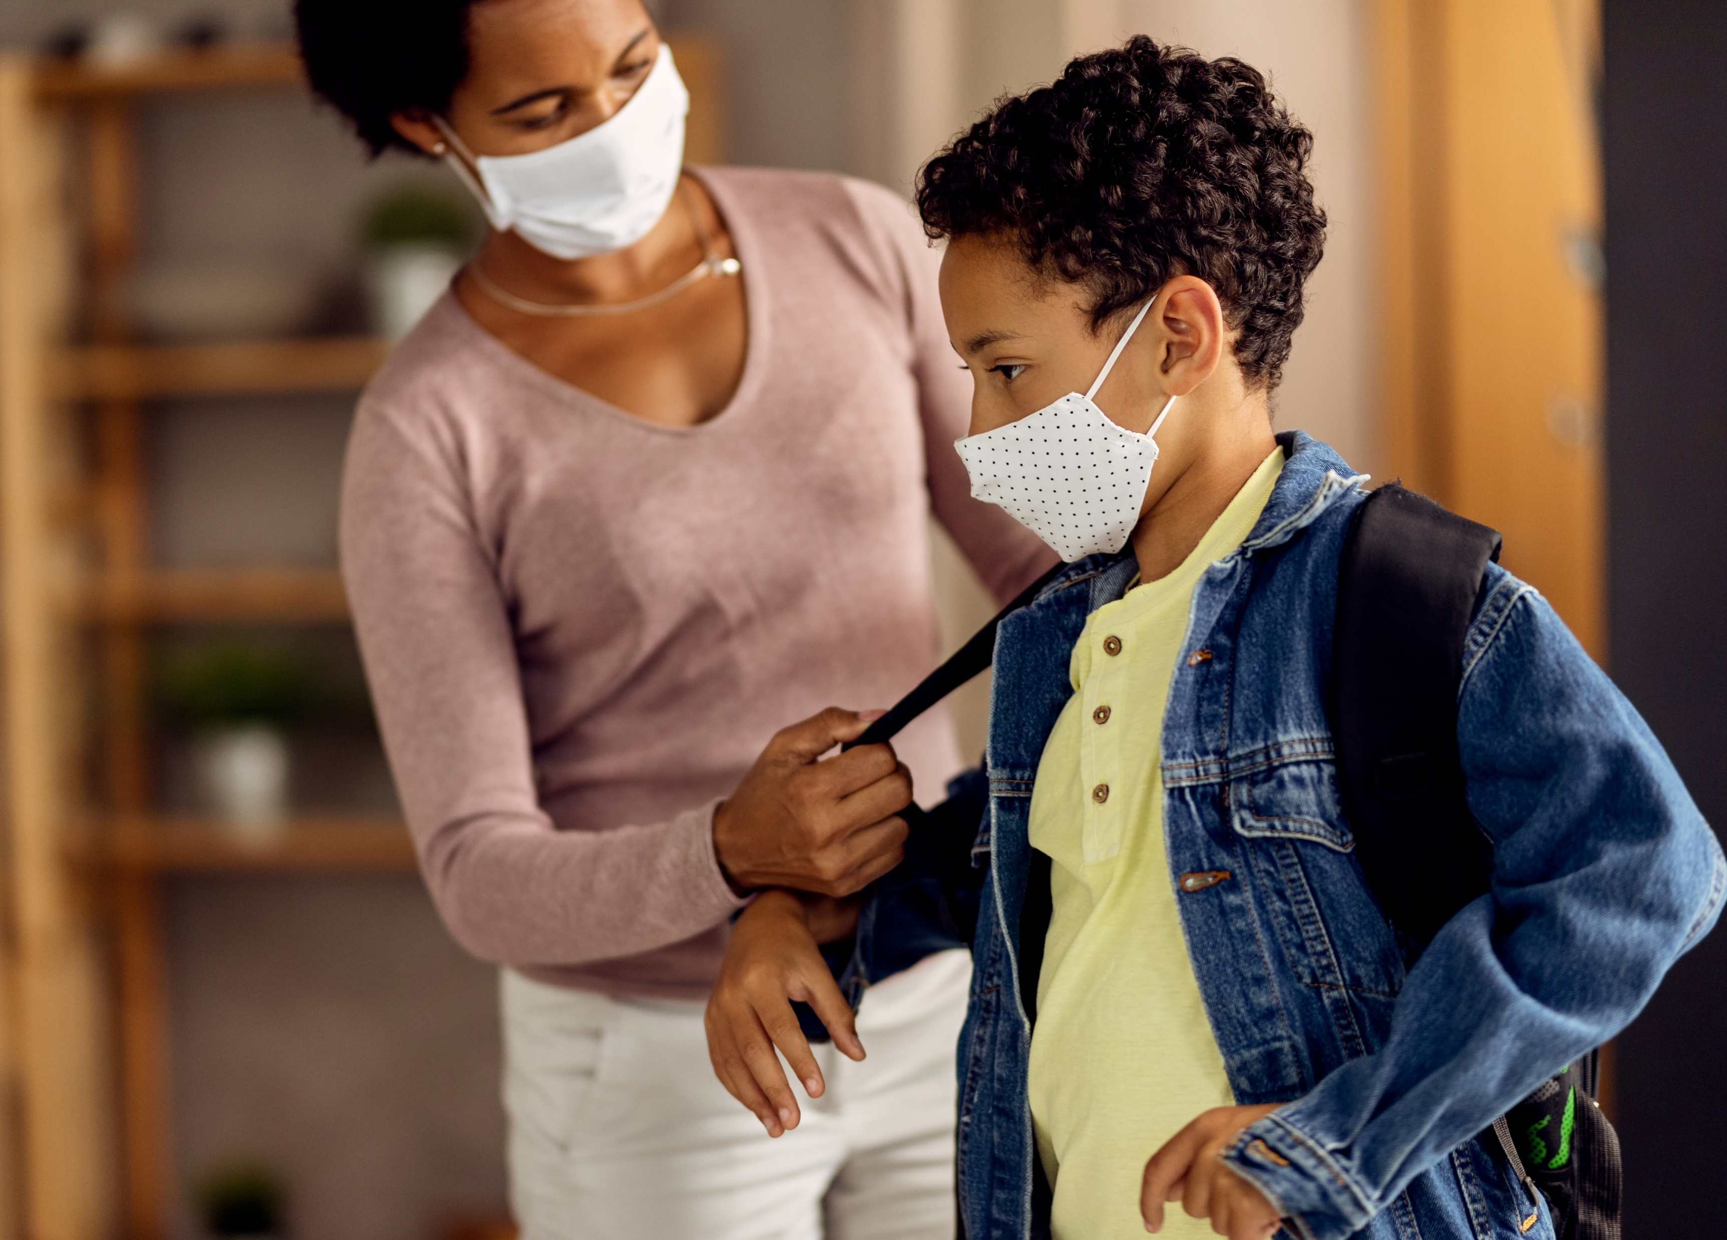
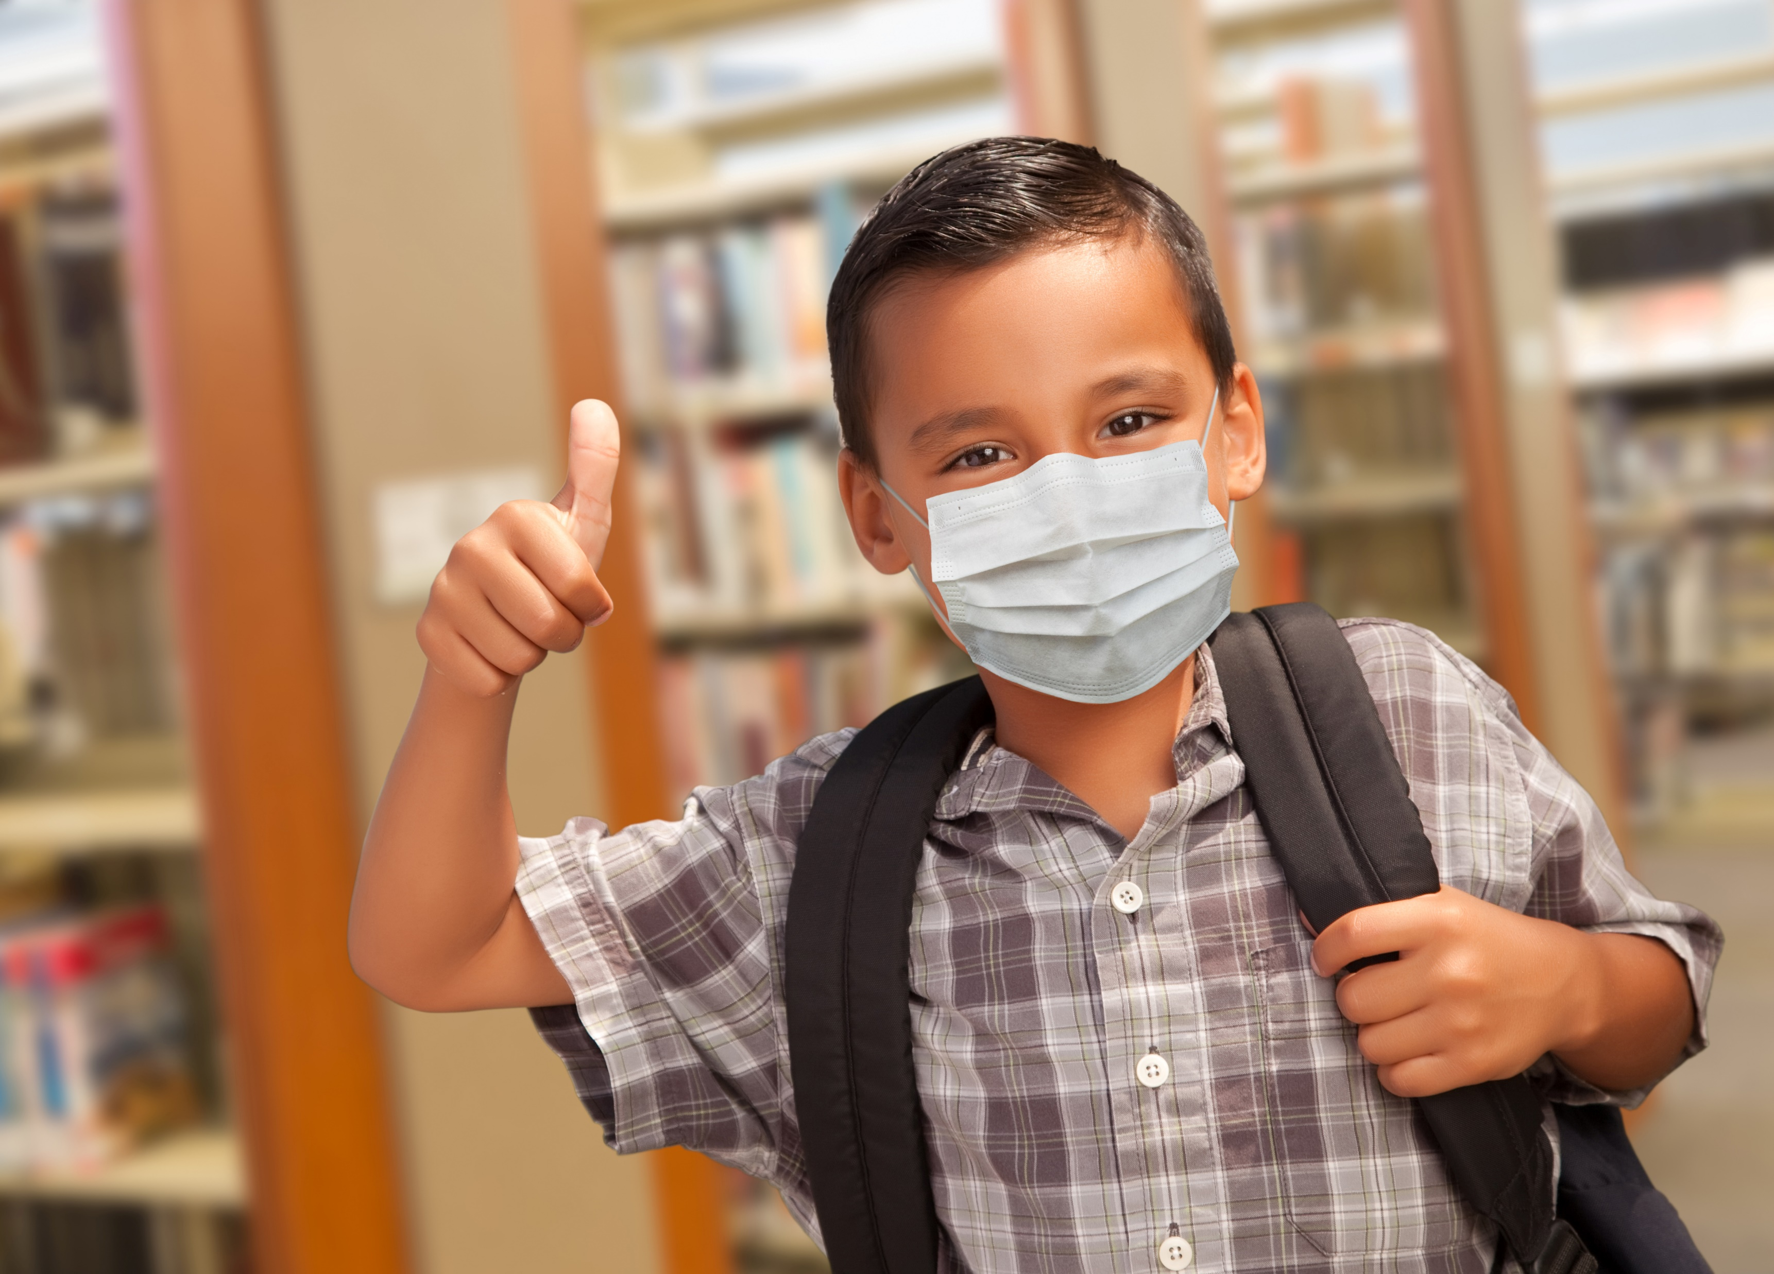
Links to Helpful Resources
General Resources
The We Can Do This campaign website has a variety of resources—including fact sheets, social media ads, posters, flyers, and videos—that you can use to help spread the Campaign messages in your community.
The CDC website has dedicated COVID-19 resources for schools and child-care programs.
The U.S. Department of Education website has a page dedicated to COVID-19 resources for schools, students, and families.

Slide 12
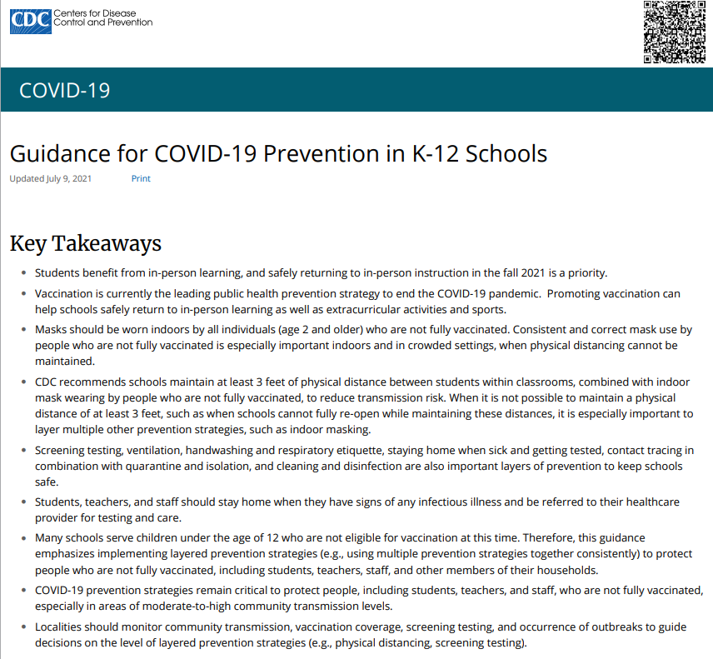
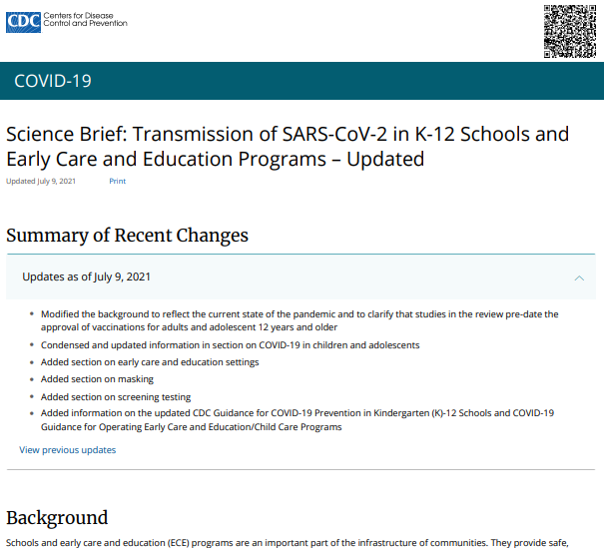
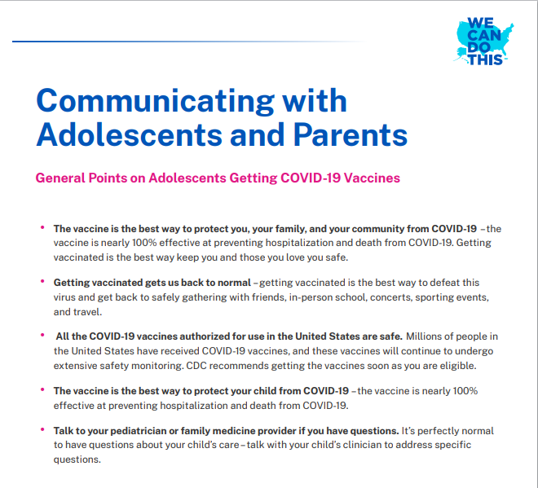
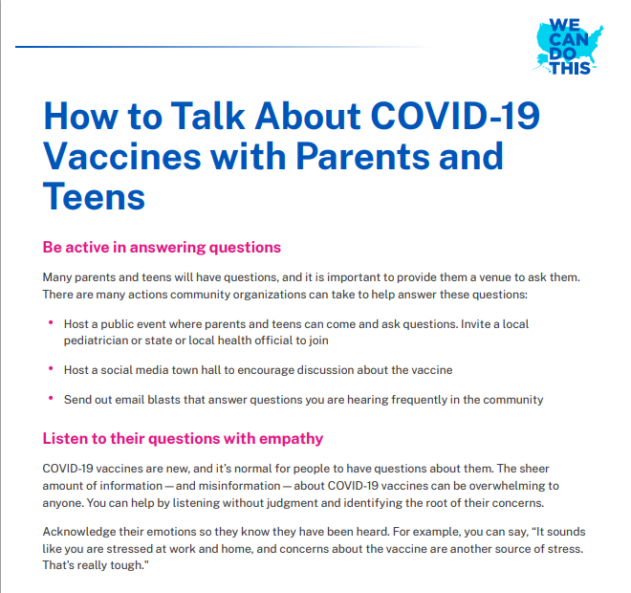
Links to Helpful Resources (Continued)
Specific Resources
CDC Guidance for COVID-19 Prevention in K–12 Schools
CDC Science Brief: Transmission of SARS-Cov-2 in K–12 Schools
Communicating with Adolescents and Parents
How to Talk About COVID-19 Vaccines With Parents and Teens

Slide 13
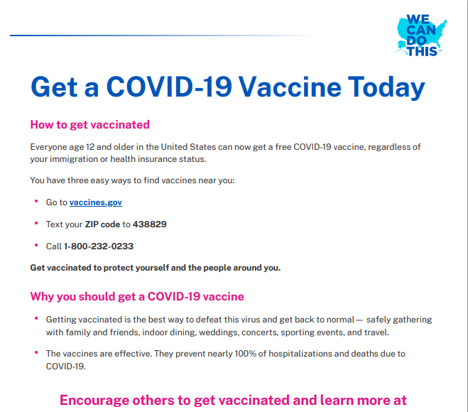
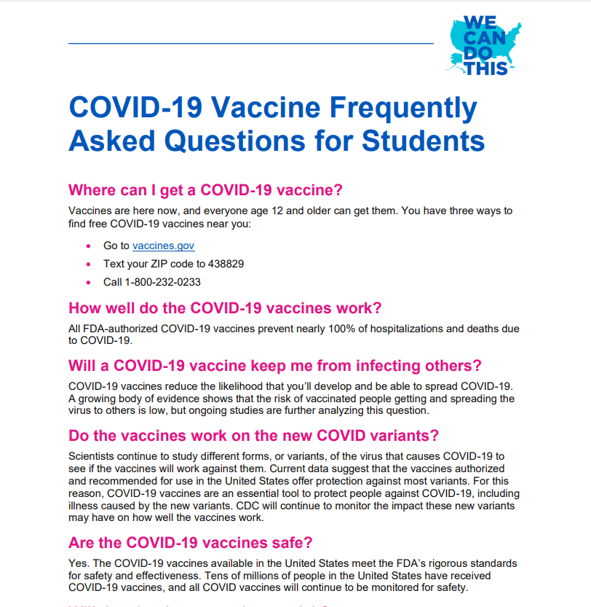
Links to Helpful Resources (Continued)
Specific Resources
Flyer: Get a COVID-19 Vaccine Today
COVID-19 Vaccine FAQs for Students

Slide 14
Meeting Presentation Template

Slide 15
The Safety of Our Students Is Our Priority
Important information for parents about COVID-19

Slide 16
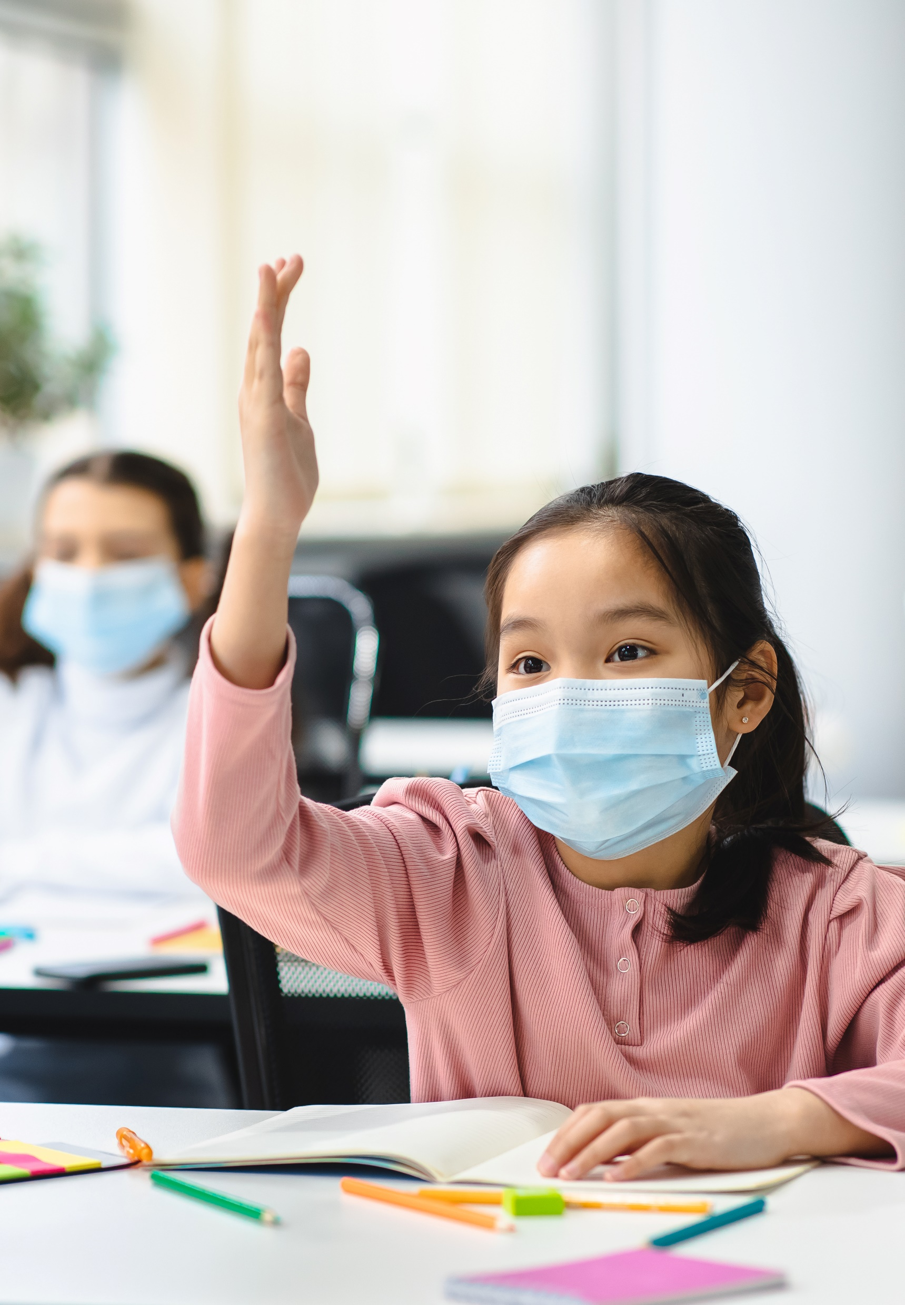
Meeting Agenda
Welcome and COVID-19 situation in our school district update
  [Include name of person(s) who will present and approximate running time]
Our school’s plan for keeping students safe
  [Include name of person(s) who will present and approximate running time]
Important information on COVID-19 vaccines
  [Include name of person(s) who will present and approximate running time]
How parents can help
  [Include name of person(s) who will present and approximate running time]
Questions?

Slide 17
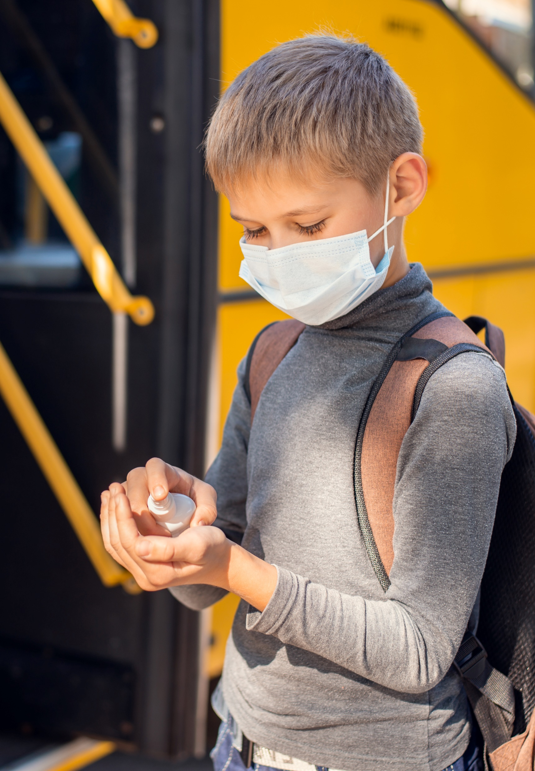
COVID-19 Situation Update
COVID-19 transmission in our district is currently [low/moderate/substantial/high: select the current indicator and explain the reason why].
Vaccine coverage in our district is currently [0–29.9%/30–39.9%/40–49.9%/50–69.9%/70%+: select the current percentage].
[Consider including information about faculty vaccination coverage, if known.]
[Consider including information about past or recent COVID-19 outbreaks among faculty/students.]

Slide 18
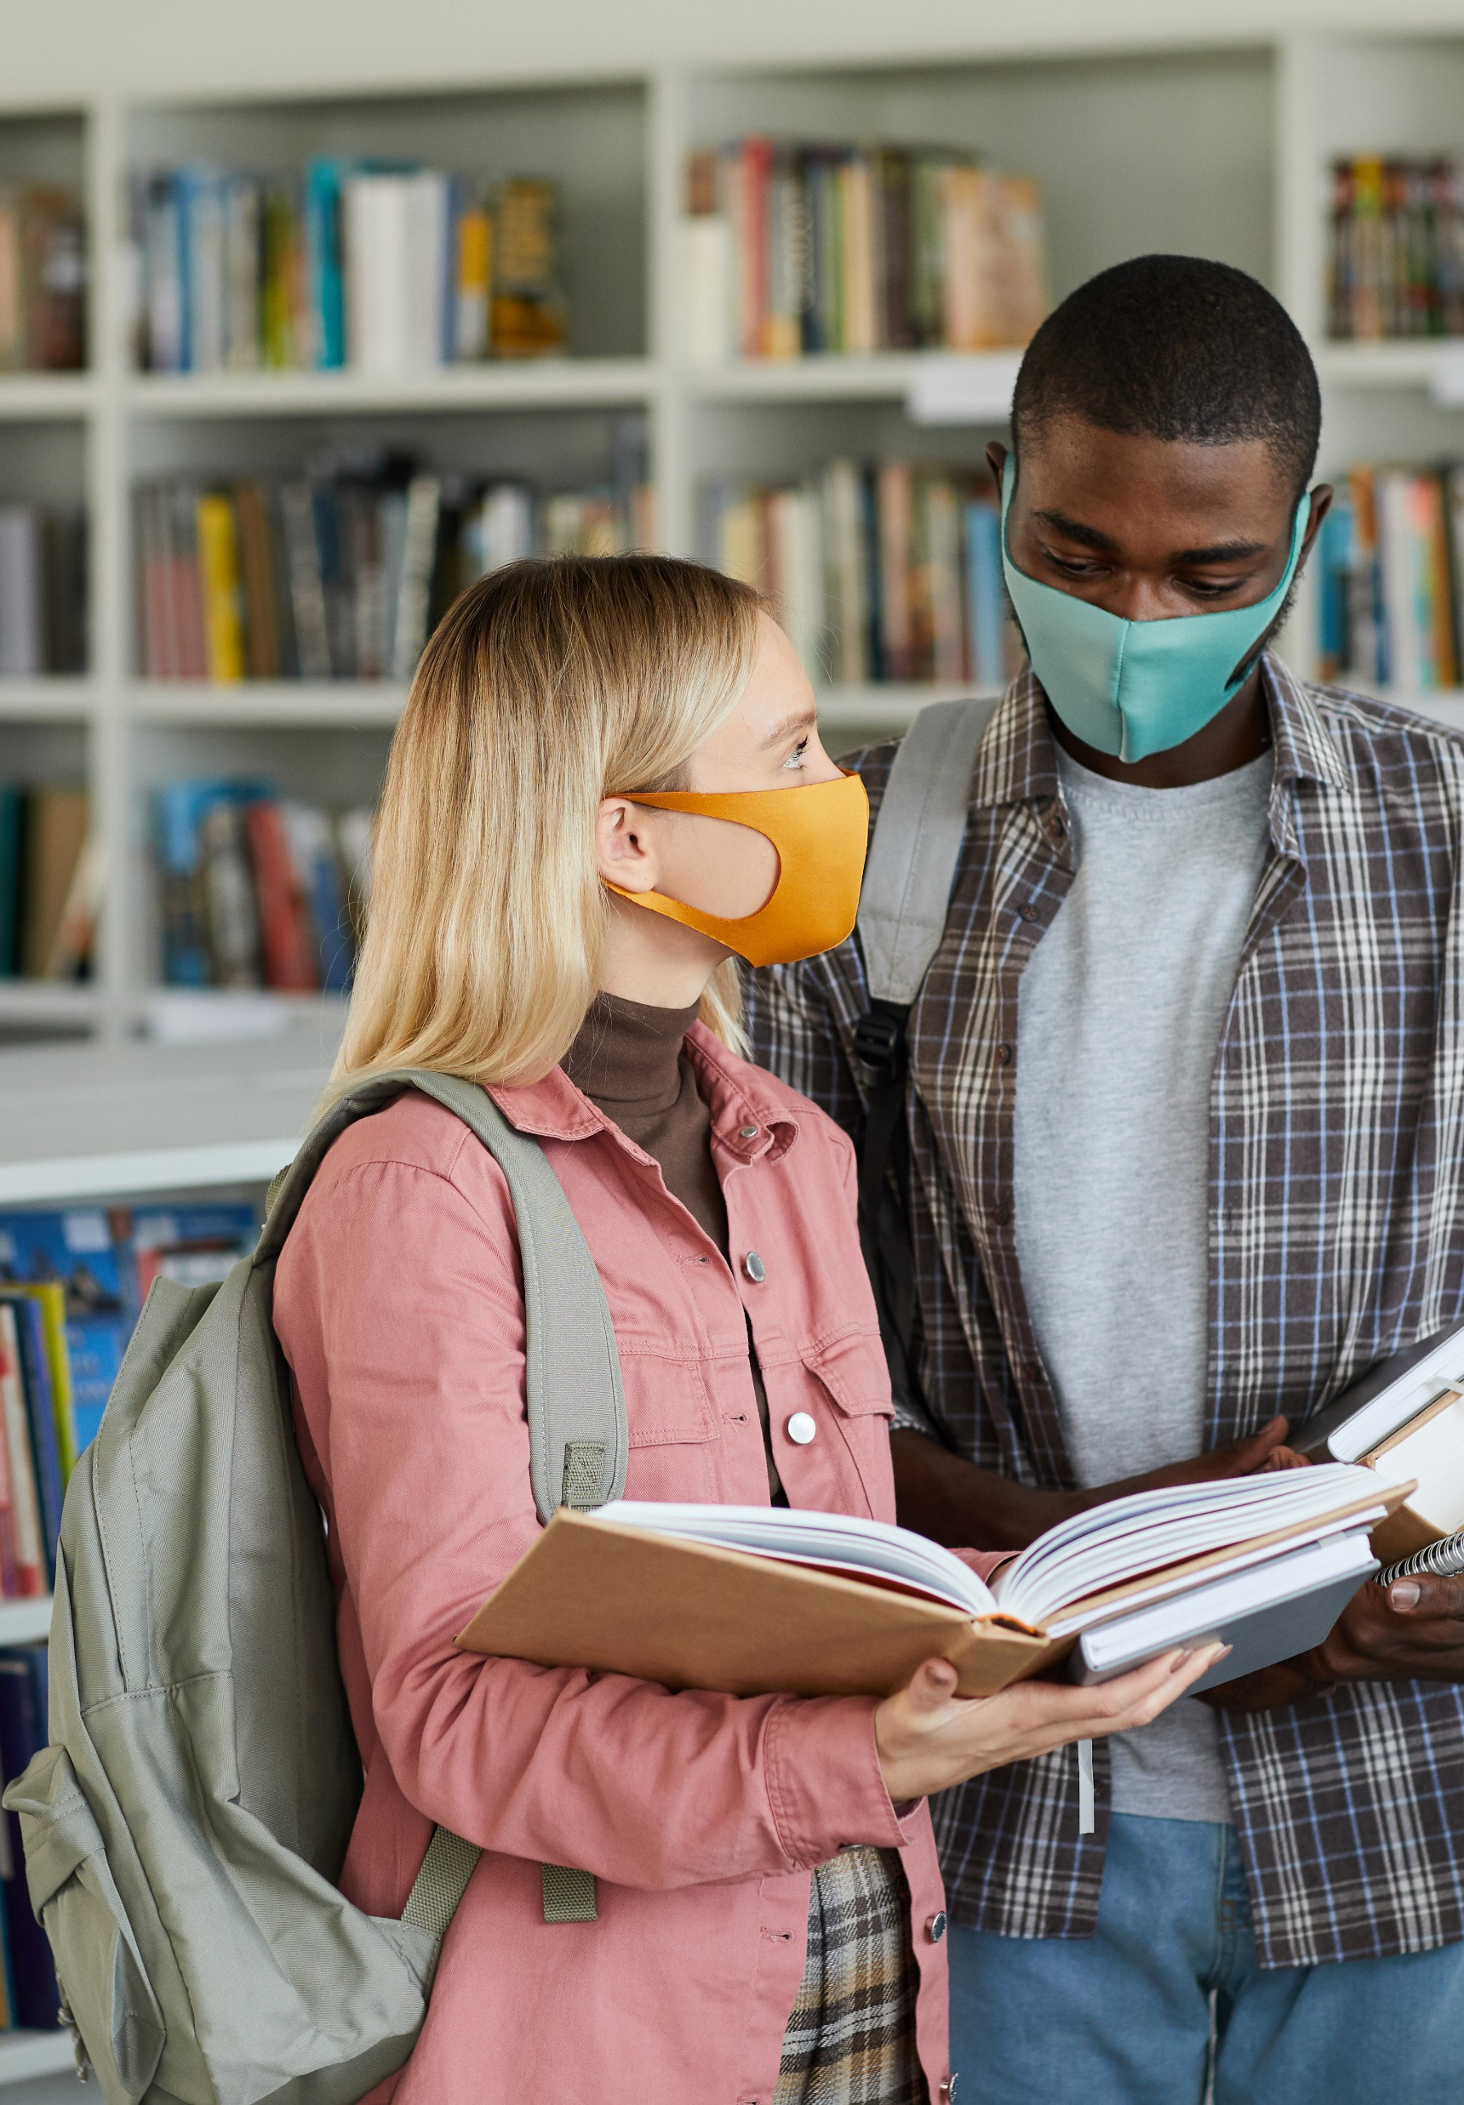
Plan for Keeping Students Safe
[List the safety protocols you’ve adopted at your school to keep students safe from the virus that causes COVID-19. Such protocols could include promoting vaccination; consistent and correct mask use; physical distancing (including virtual classrooms); screening testing to promptly identify cases, clusters, and outbreaks; ventilation; handwashing and respiratory etiquette; staying home when sick and getting tested; contact tracing, in combination with isolation and quarantine; and cleaning and disinfection.]
[Provide relevant links and contact information that parents would find helpful.]

Slide 19
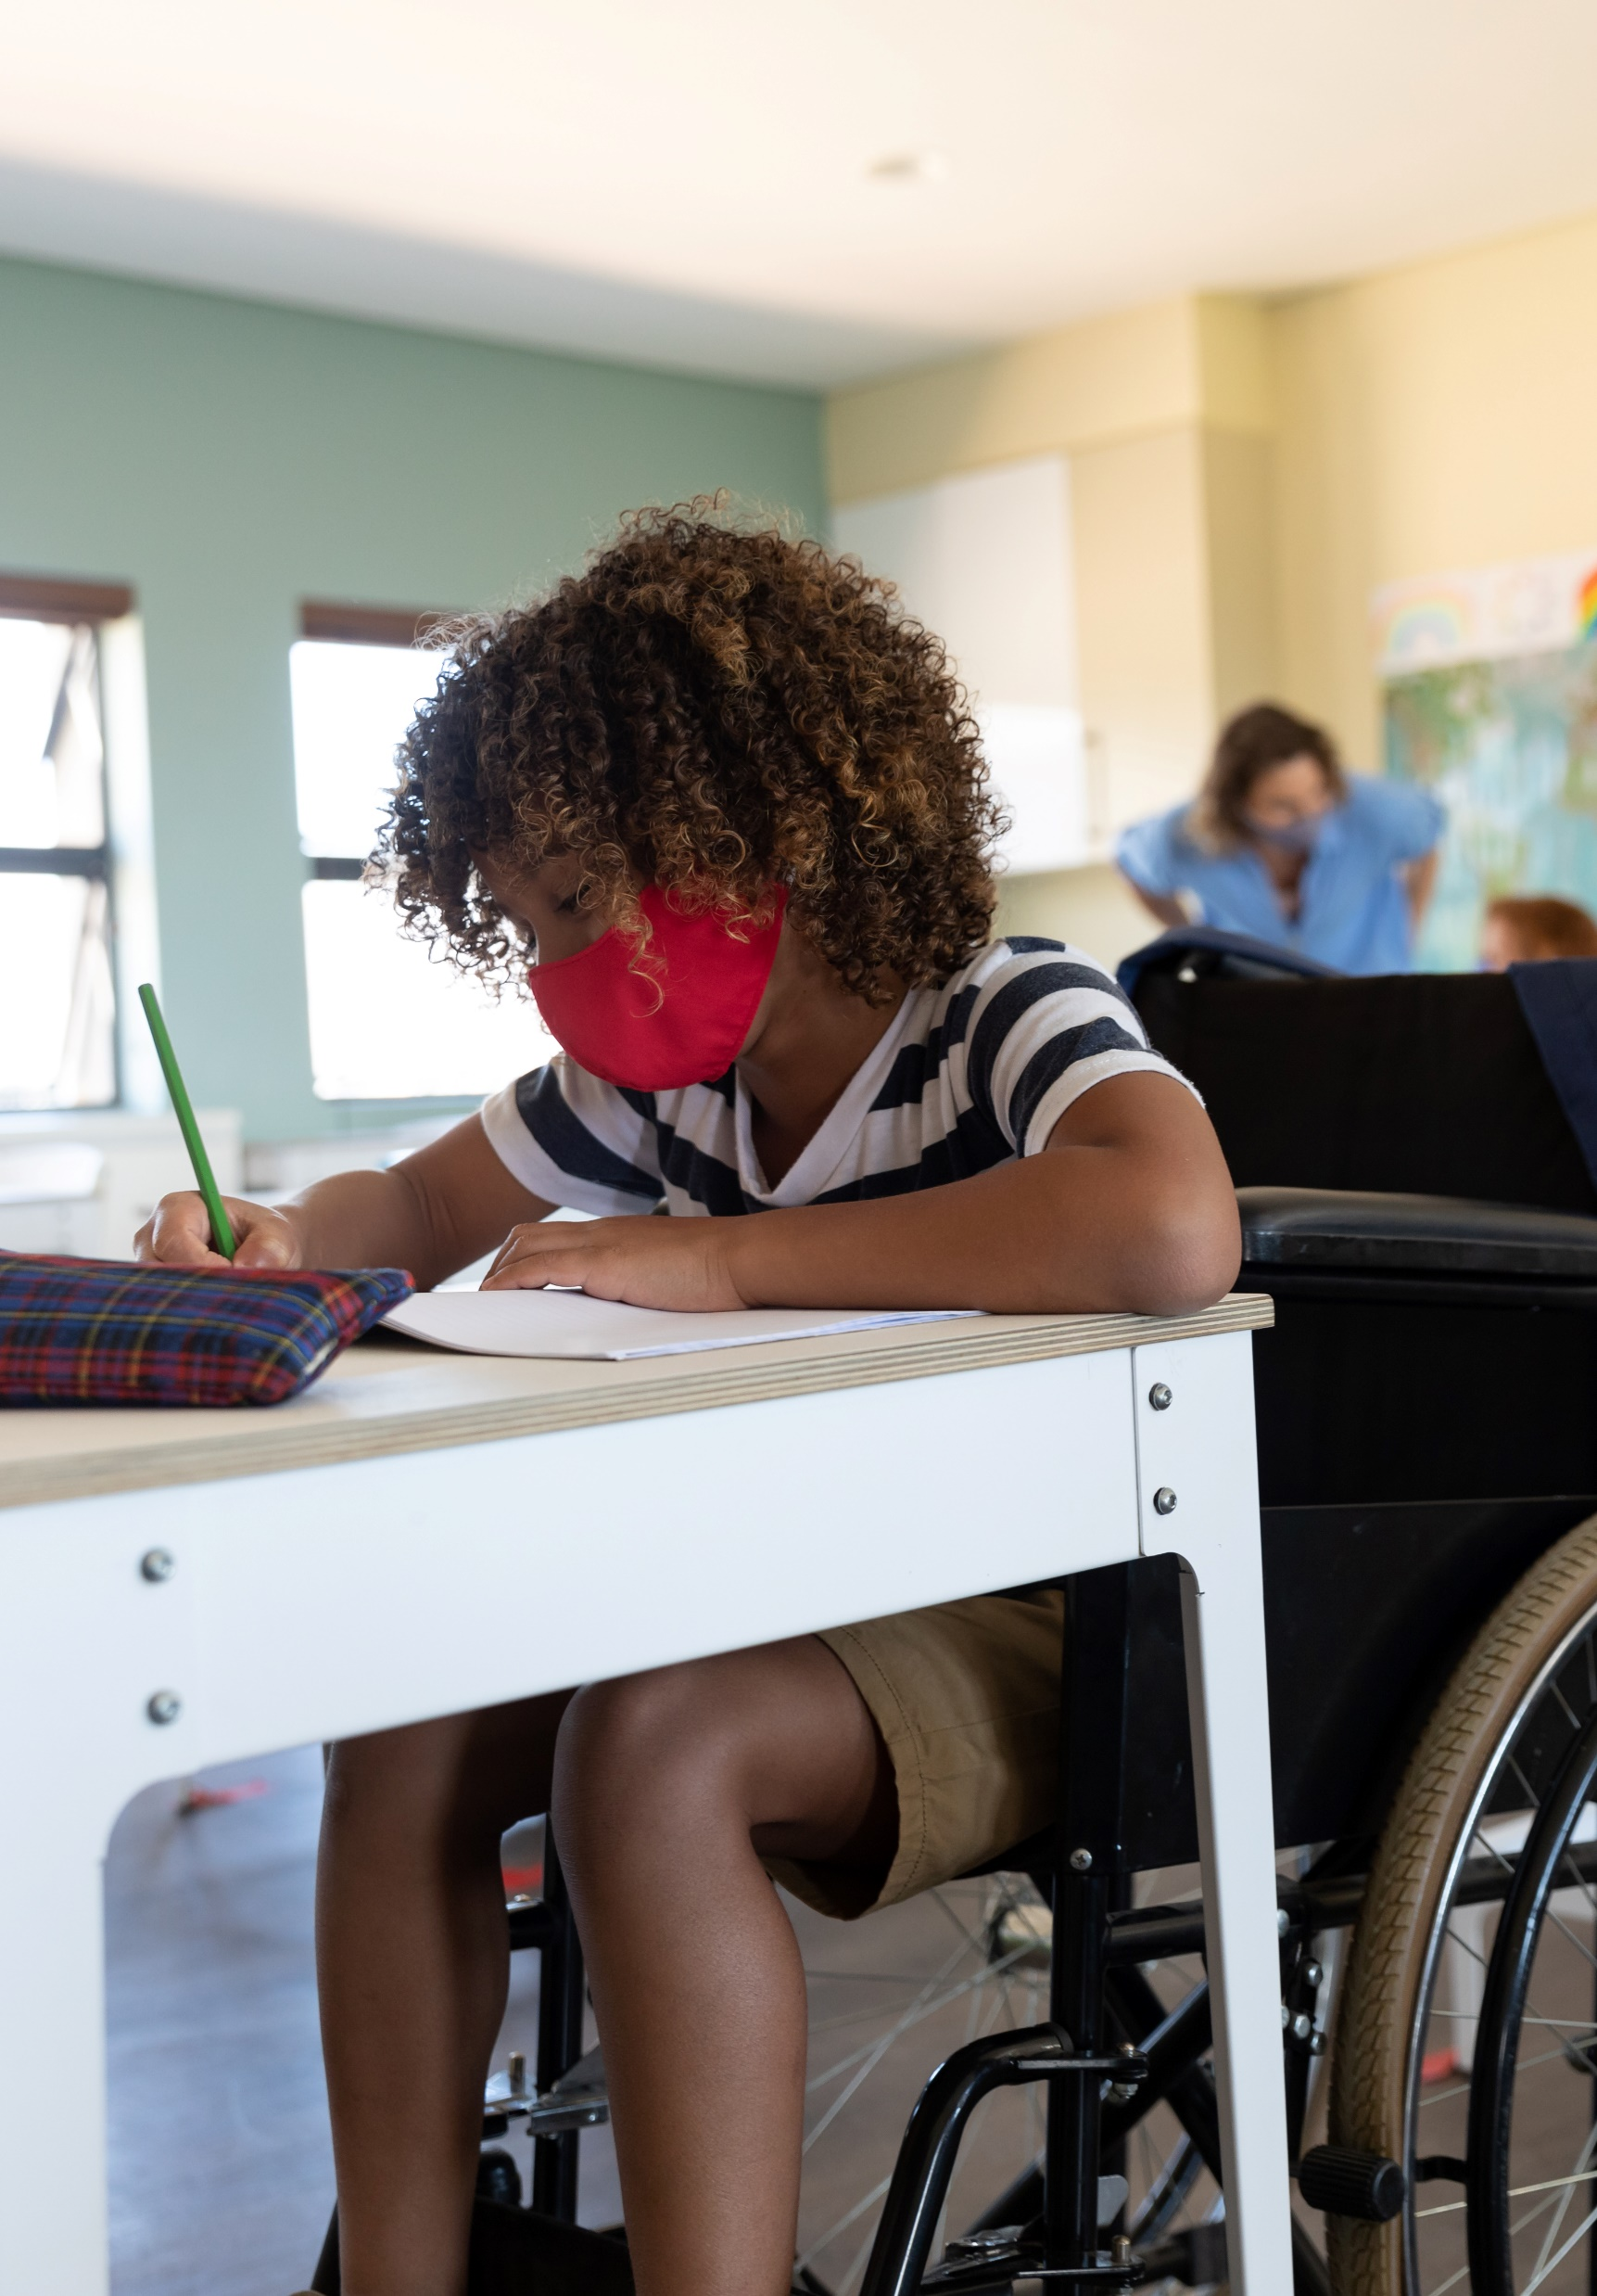
Important Information on COVID-19 Vaccines
The following slides contain the most up-to-date information from CDC on COVID-19 vaccines
Availability
Effectiveness
Safety

Slide 20
COVID-19 Vaccines Are Available
Vaccines are here now and everyone age 5 and older can get them.
You have three easy ways to find vaccines near you:
  Visit vaccines.gov
  Text your ZIP code to 438829
  Call 1-800-232-0233

Slide 21
COVID-19 Vaccines Are Free
COVID-19 vaccines are free for everyone in the United States, regardless of your citizenship status and whether you have health insurance.
Receiving a COVID-19 vaccine, as well as testing and treatment for COVID-19, doesn’t negatively affect your immigration process or your family.

Slide 22

COVID-19 Vaccines Are Effective
The available COVID-19 vaccines are safe and highly effective at preventing severe illness, hospitalization, and death due to COVID-19, including from Delta and other known variants.
For the strongest protection against COVID-19, you need all recommended doses:
  Johnson & Johnson’s Janssen vaccine requires one initial dose.
  The Pfizer-BioNTech and Moderna vaccines require two initial doses.
If you meet the criteria for having a compromised immune system, you should get a third dose of the Pfizer-BioNTech or Moderna vaccine at least 4 weeks after your second dose.
If you’ve been vaccinated, you may be eligible for booster shots to keep up your protection. See the latest guidance on boosters.

Slide 23
COVID-19 Vaccines Are Safe
Millions and millions of people around the world have safely received a COVID-19 vaccine.
Over 338 million doses of COVID-19 vaccine have been given in the United States as of July 19, 2021.
Results from vaccine safety monitoring efforts are reassuring. To date, experts have found only two serious types of health problems after vaccination, both of which are extremely rare and treatable:
An allergic reaction called anaphylaxis, and
A blood-clotting condition called thrombosis with thrombocytopenia syndrome after vaccination with Johnson &Johnson’s Janssen COVID-19 vaccine.
Experts have also documented extremely rare cases of myocarditis and pericarditis (heart inflammation) following vaccination with the Pfizer-BioNTech or Moderna vaccine. Most patients who received care responded well to treatment and rest and quickly felt better.

Slide 24
Once You’re Up to Date With Your COVID Vaccines
Once you’re up to date with your COVID vaccines, you can start doing many things that you had stopped doing because of the pandemic.
Until you’re up to date with your COVID vaccines, continue to:
Wear a well-fitting mask inside public places when the COVID risk to your community is high.
Stay at least 6 feet away from people who don't live with you.
Avoid crowded and poorly ventilated spaces.
Wash your hands frequently.
Learn more at cdc.gov/coronavirus.

Slide 25
Thank you

Slide 26
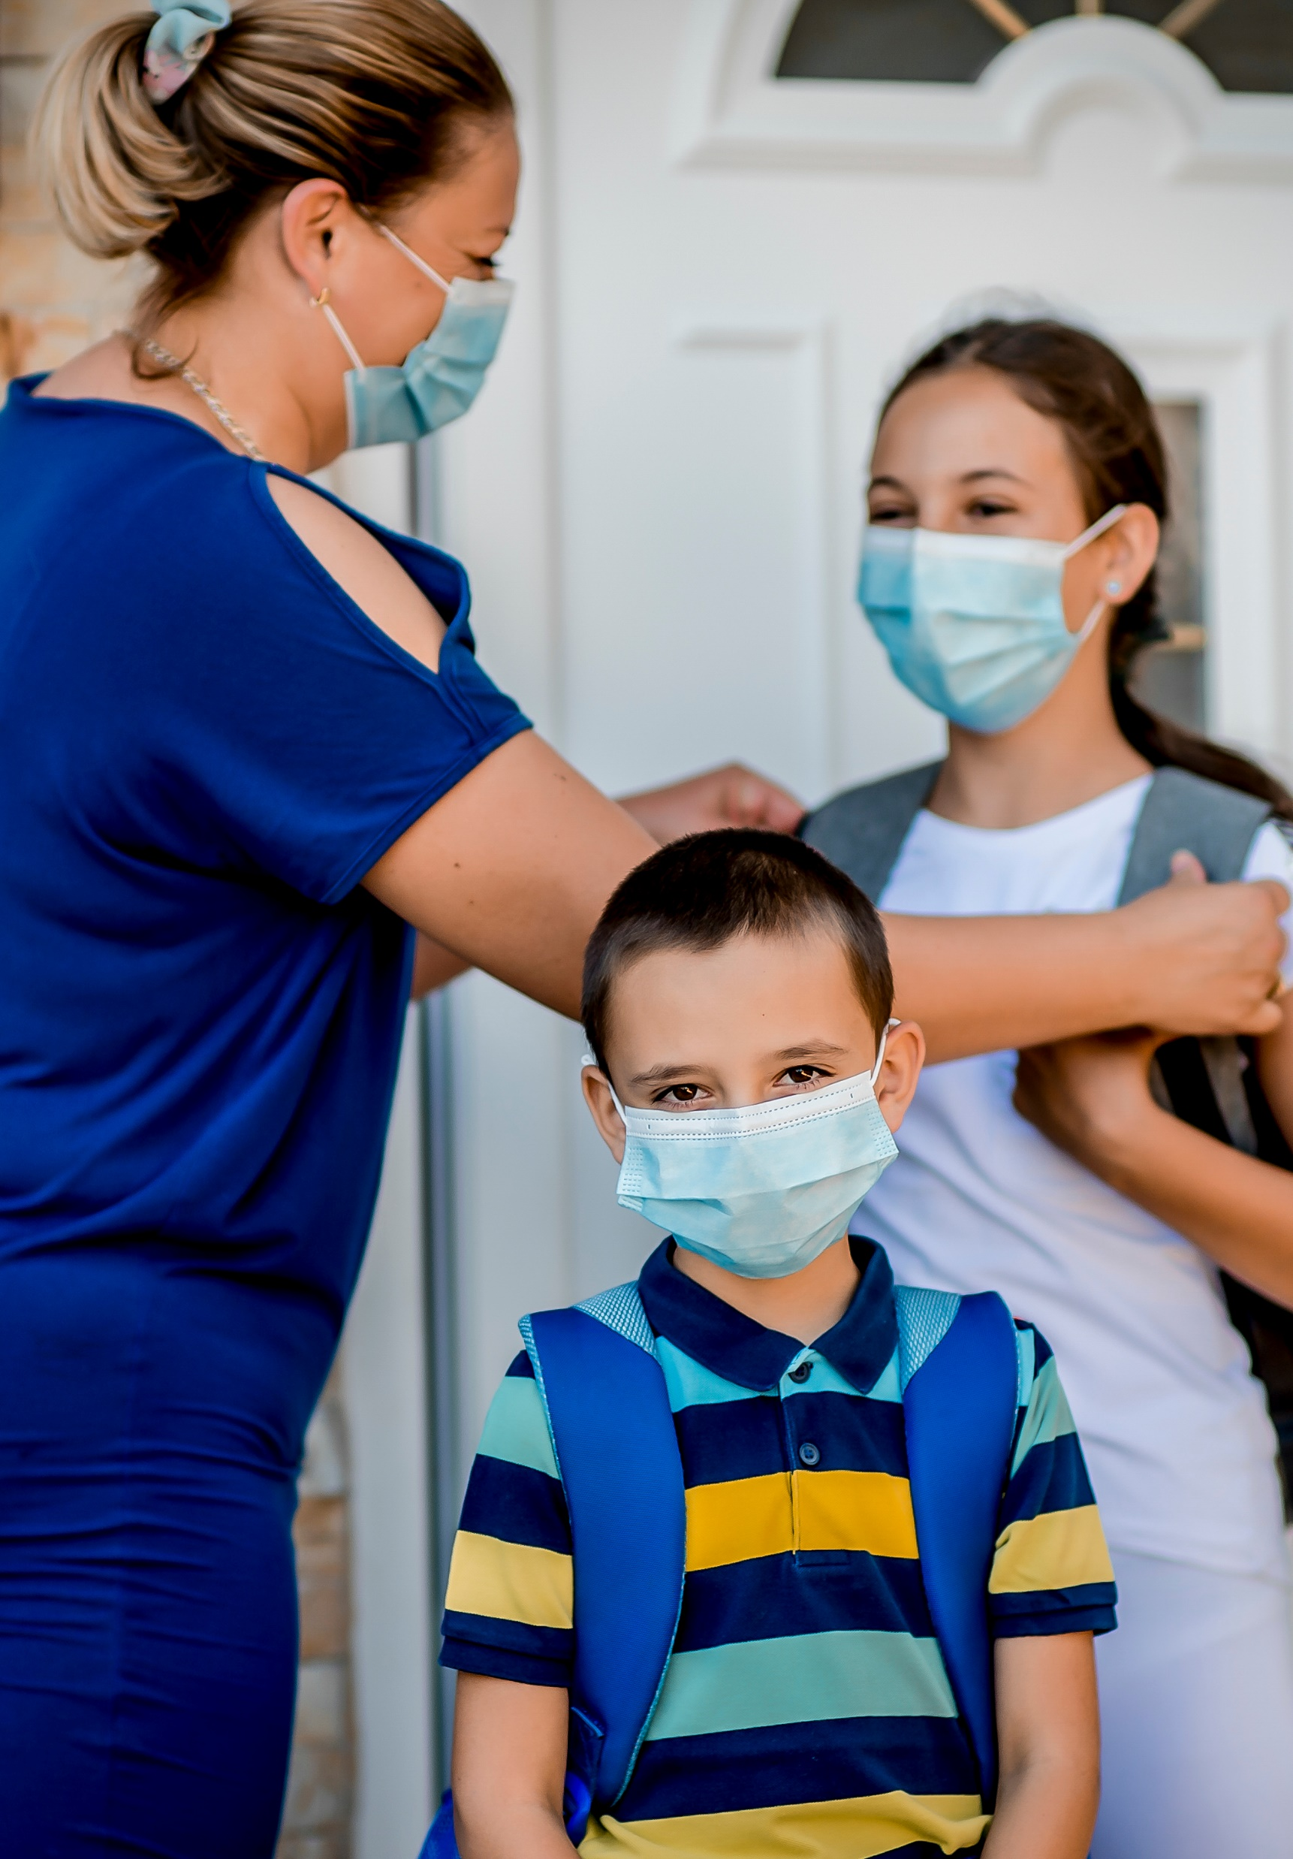
How Parents Can Help
Vaccination is the safest way to protect yourself and others from the virus that causes COVID-19.
Consider getting yourself and your children ages 5 and older vaccinated against COVID-19.
If you have any questions or concerns about the vaccines, seek out sources you can trust:
  CDC (at cdc.gov/coronavirus) or your local public health department.
  You can also trust your health care provider or a pharmacist to answer any questions you may have.

